Slide 1
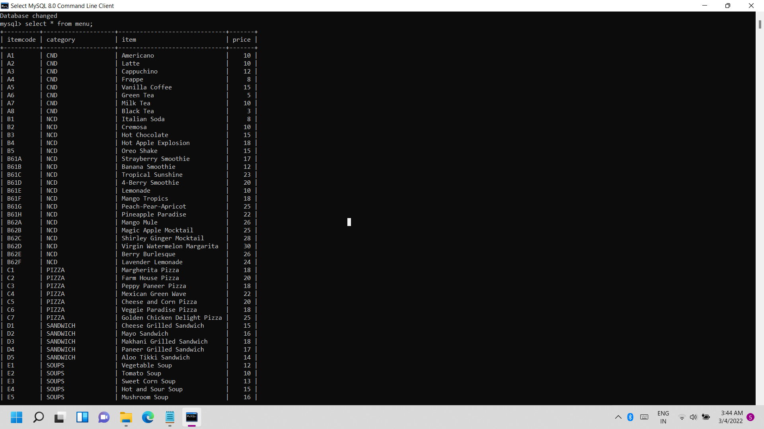
MYSQL TABLE:
Menu table

Slide 2
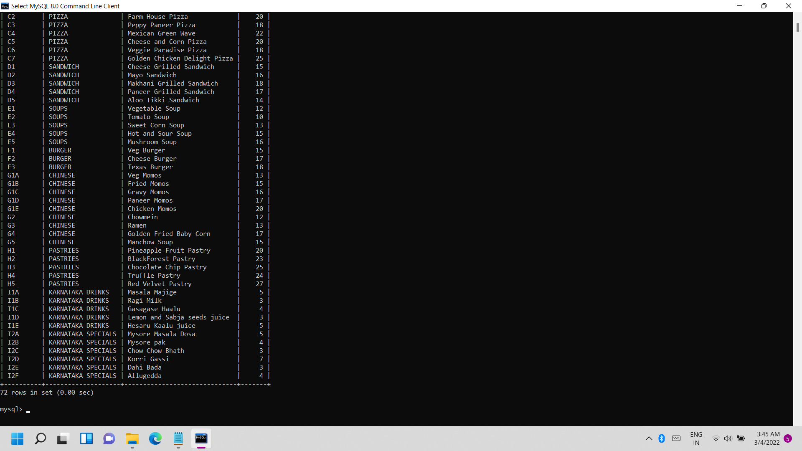

Slide 3
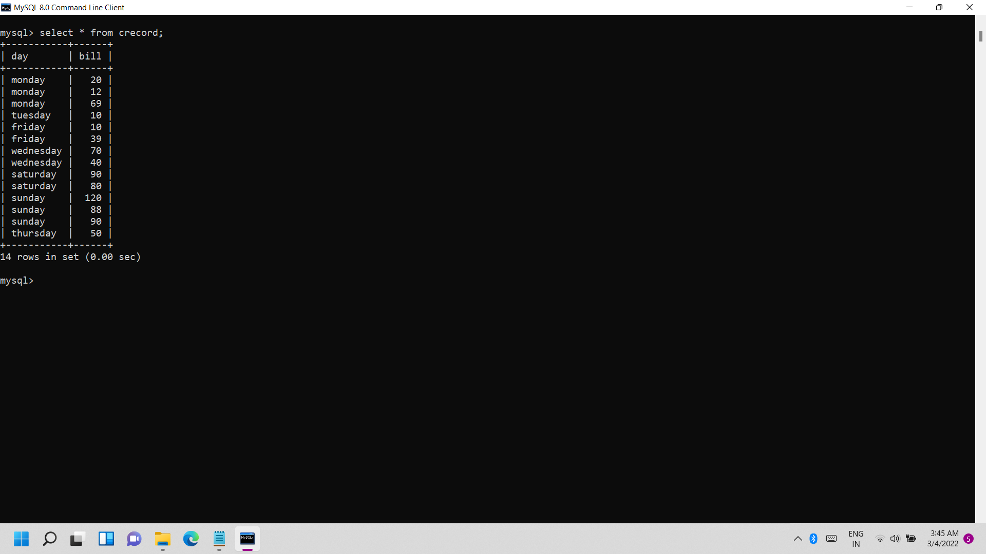
Crecord table

Slide 4
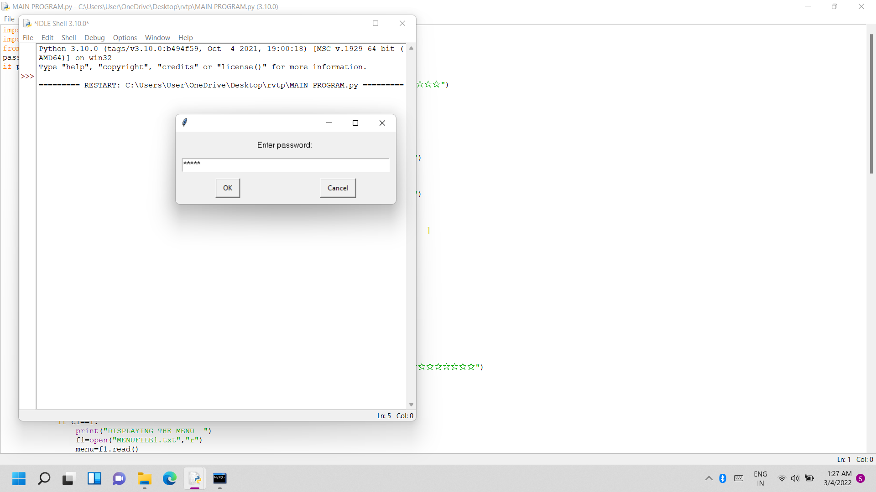
1. Displaying password box and Entering the password:

Slide 5
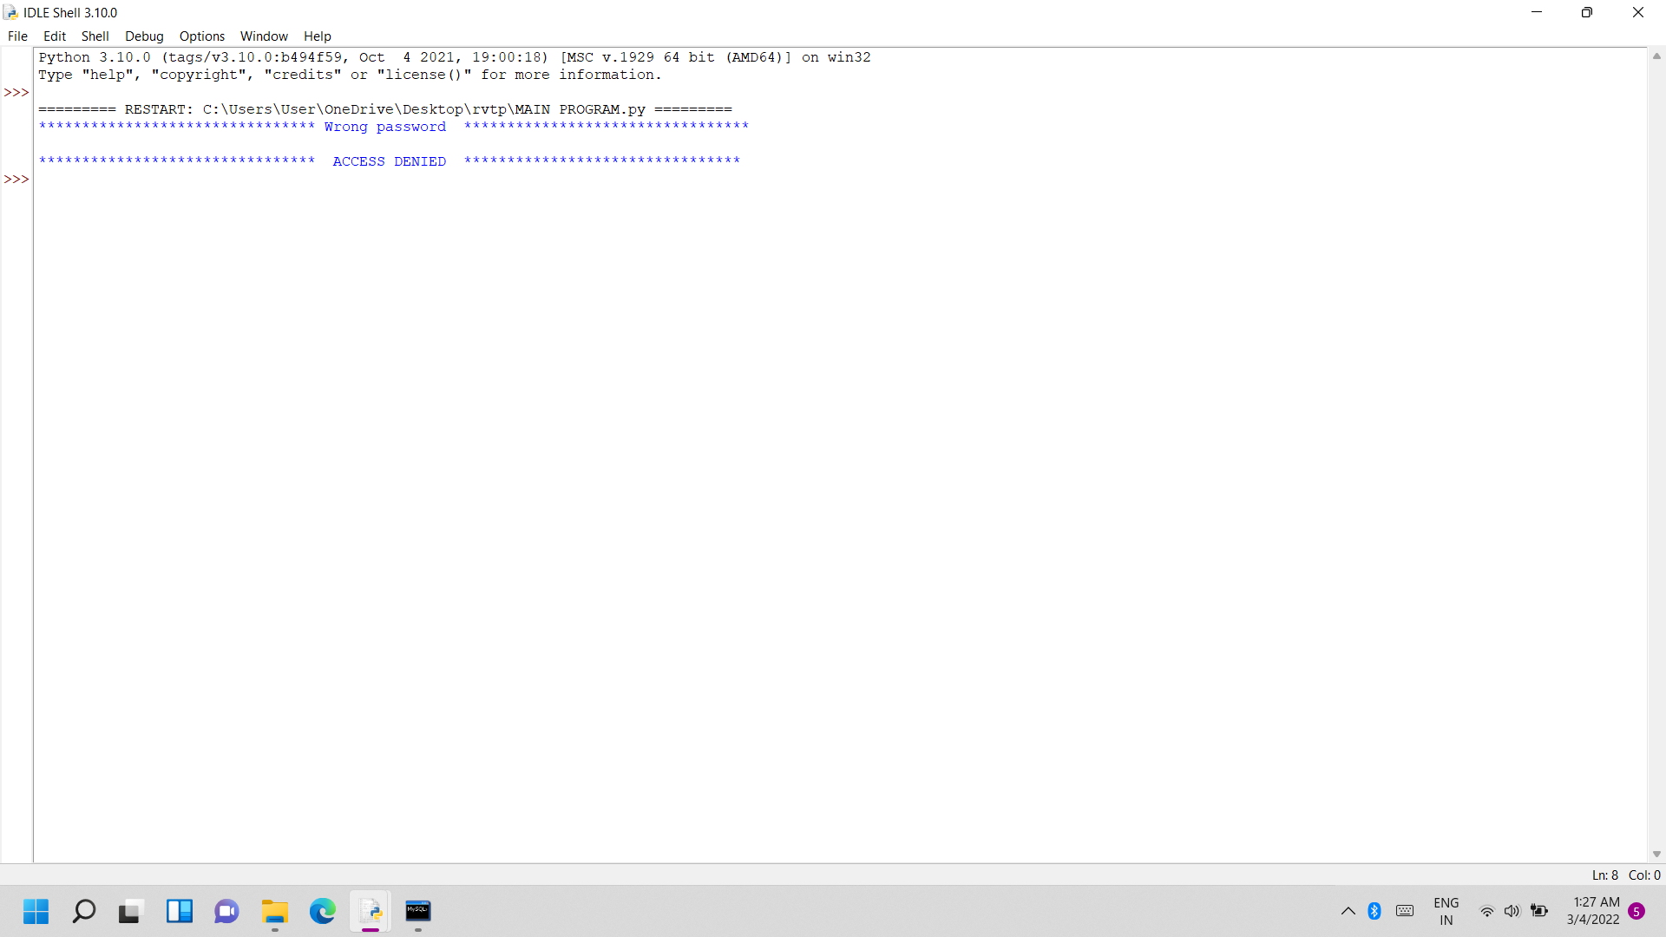
Entering wrong password:

Slide 6
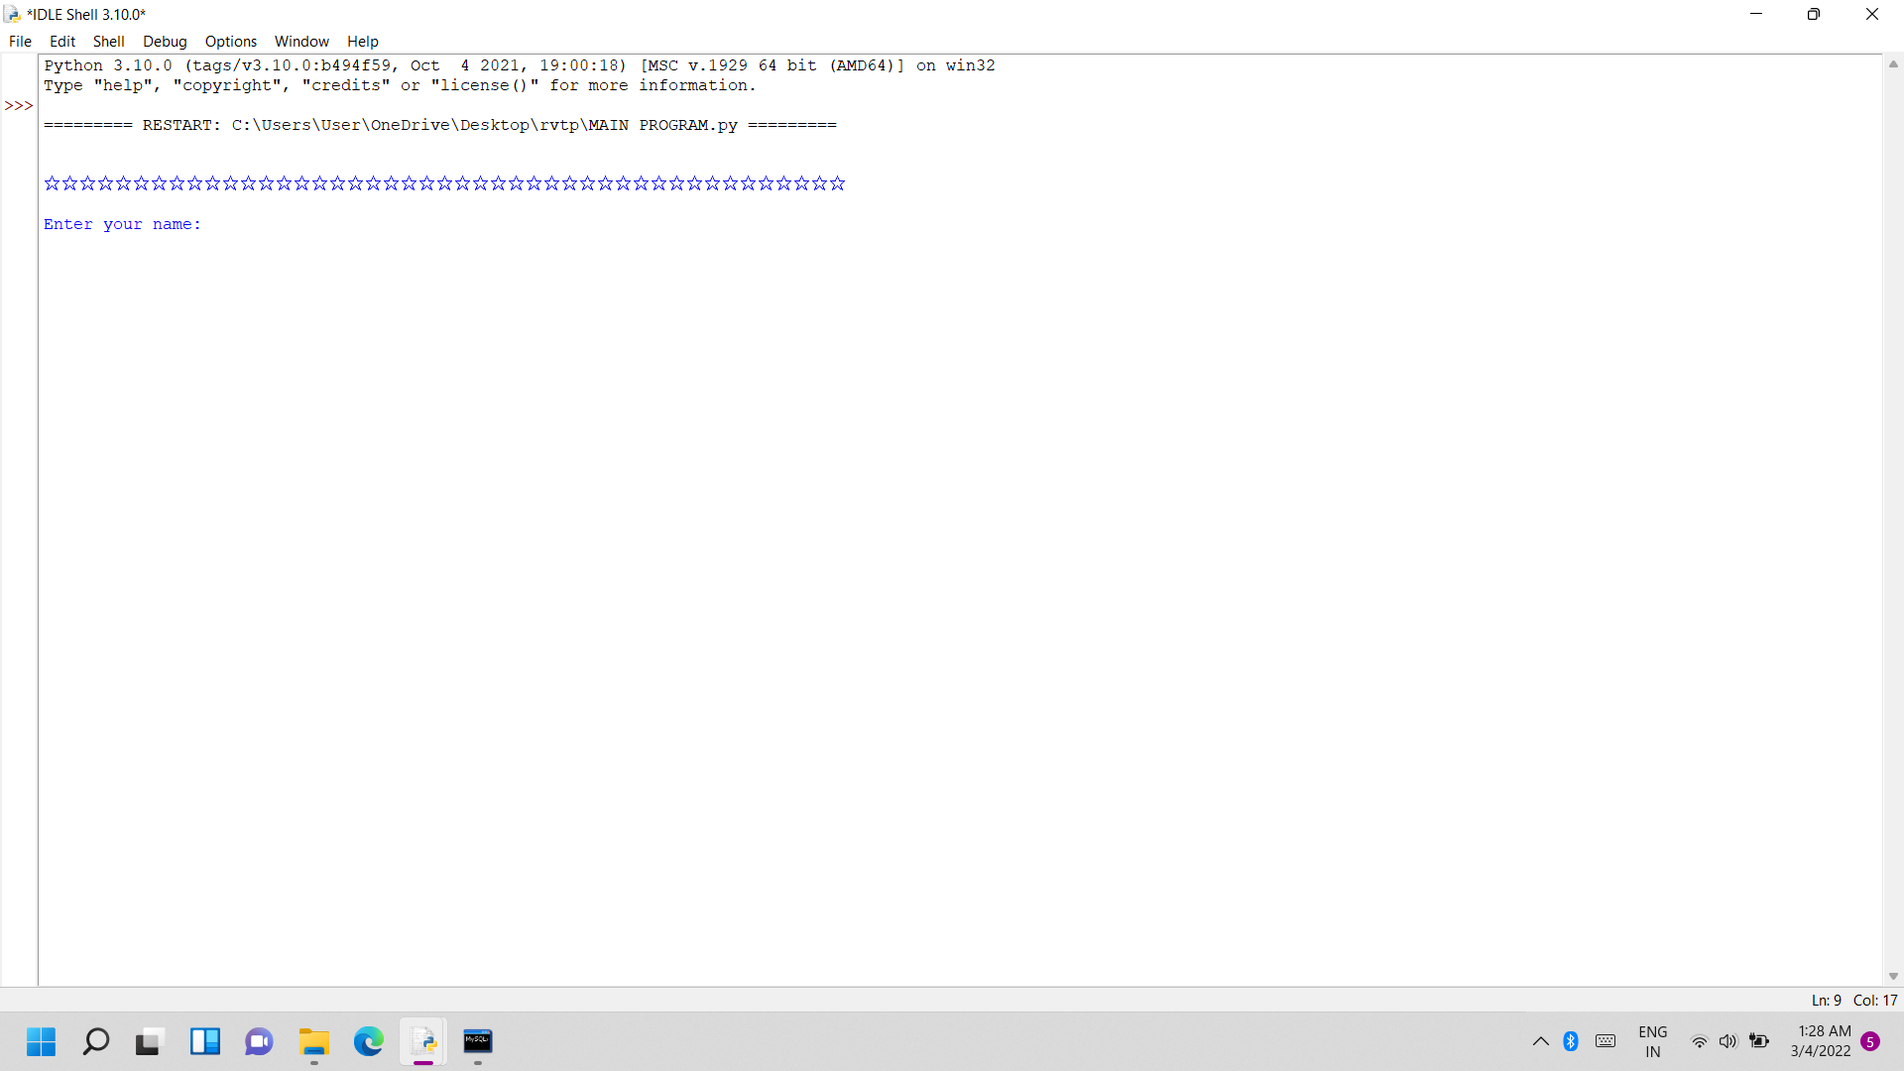
b) Entering correct password:

Slide 7
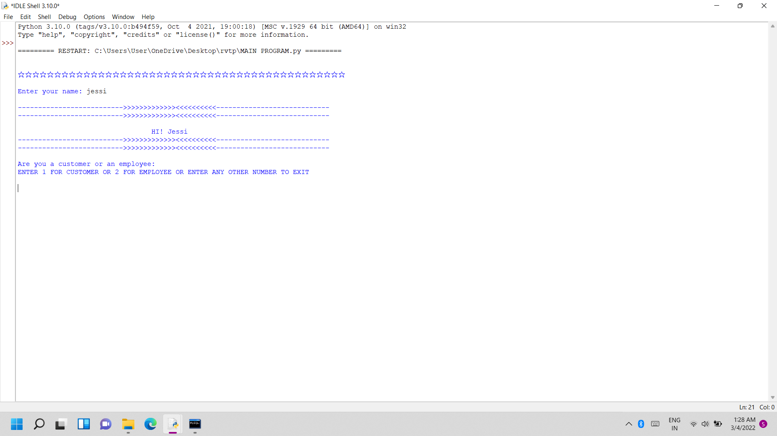
2. Customer services:
ENTERING 1 FOR CUSTOMER

Slide 8
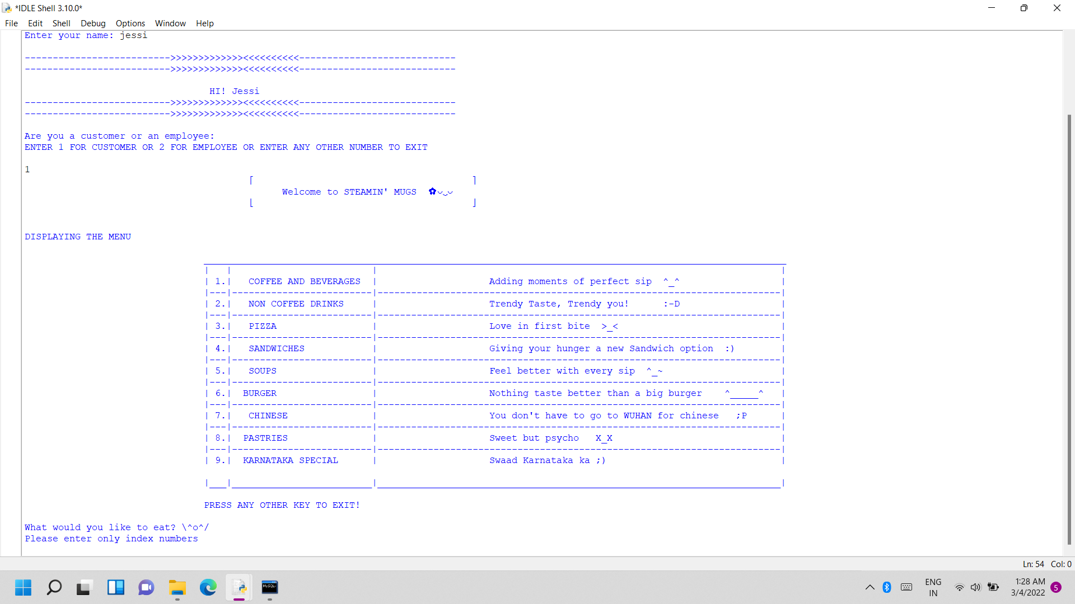
a) Displaying main menu:

Slide 9
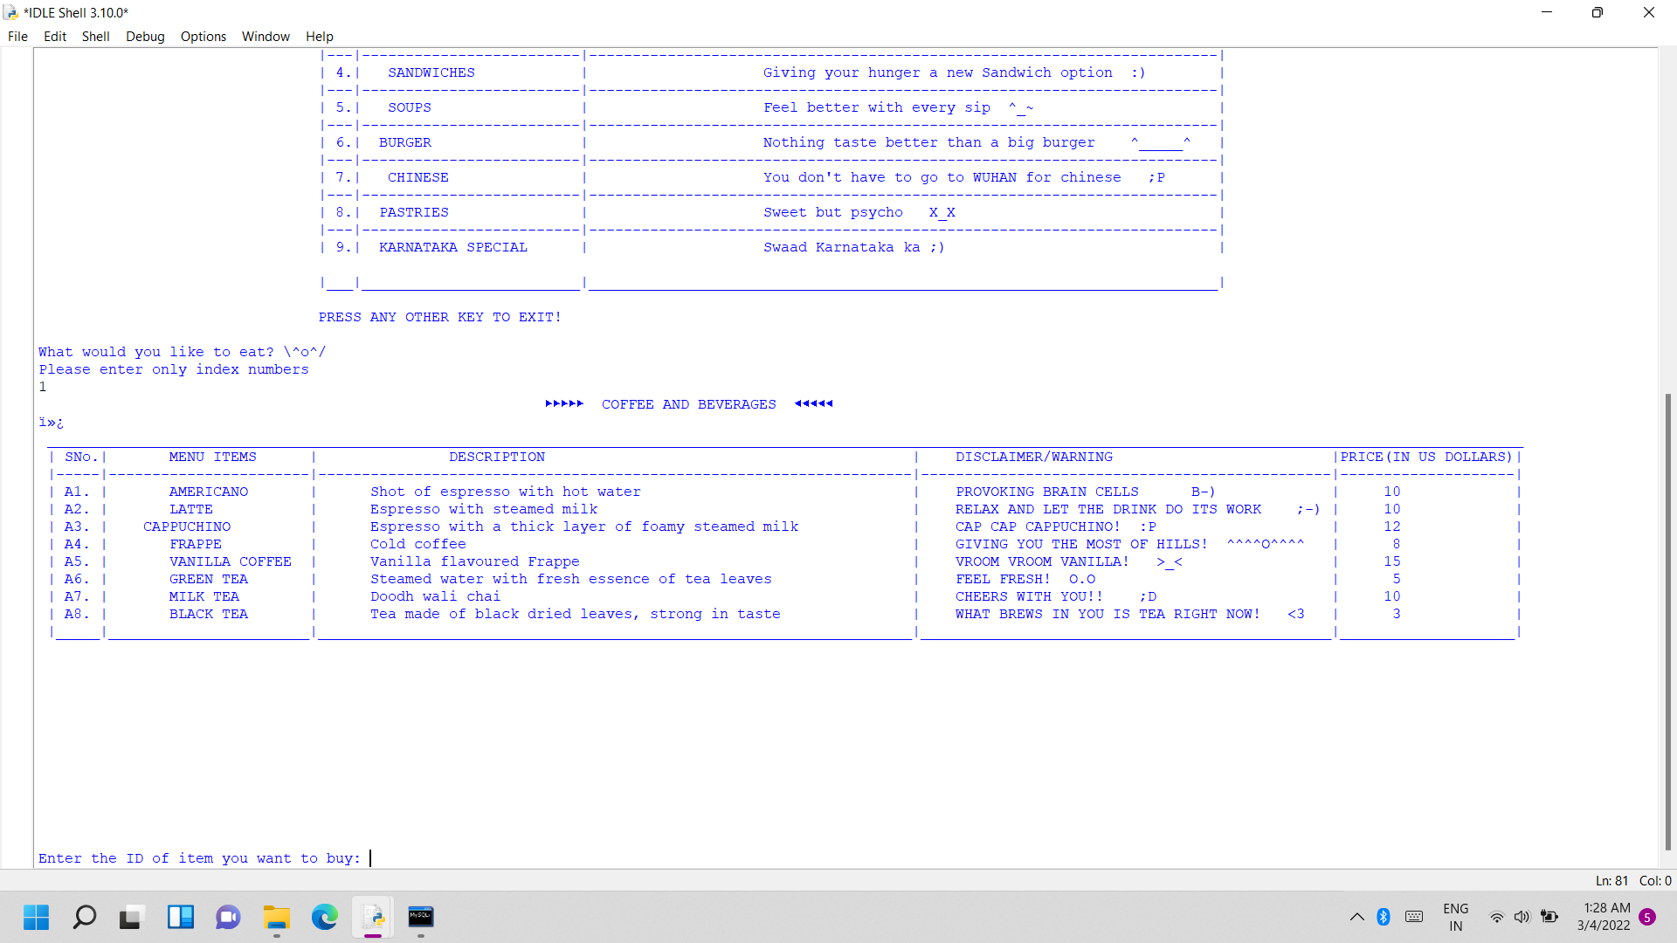
b) Displaying sub menu on request:

Slide 10
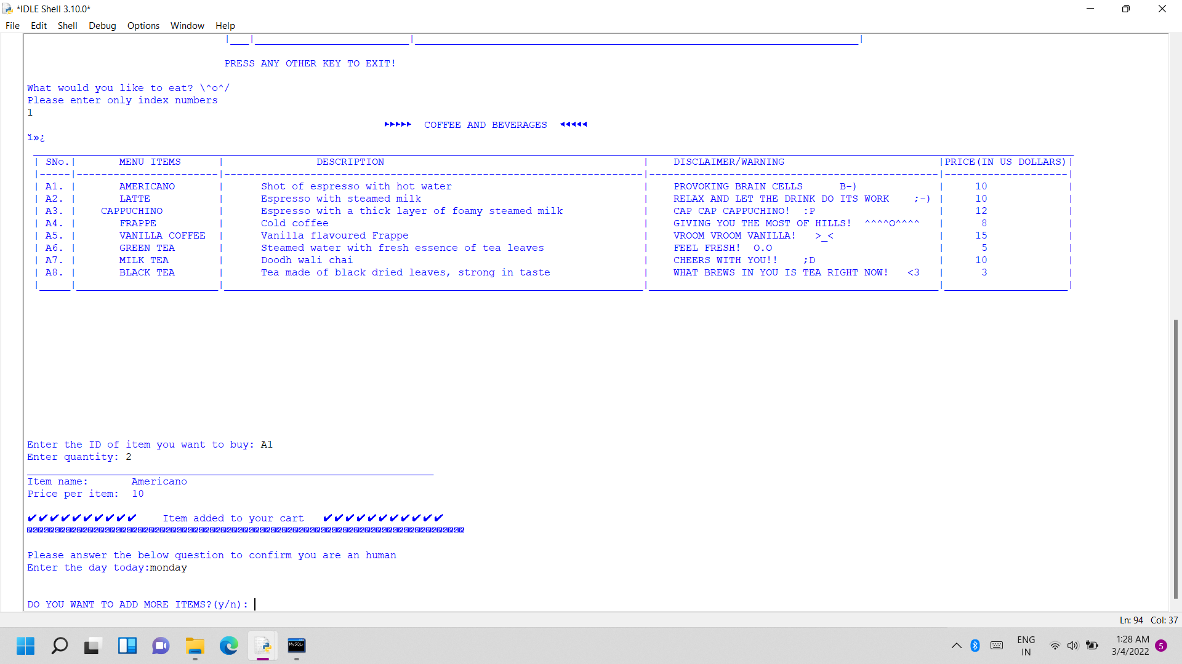
c) Customer choosing from the menu and entering the quantity:

Slide 11
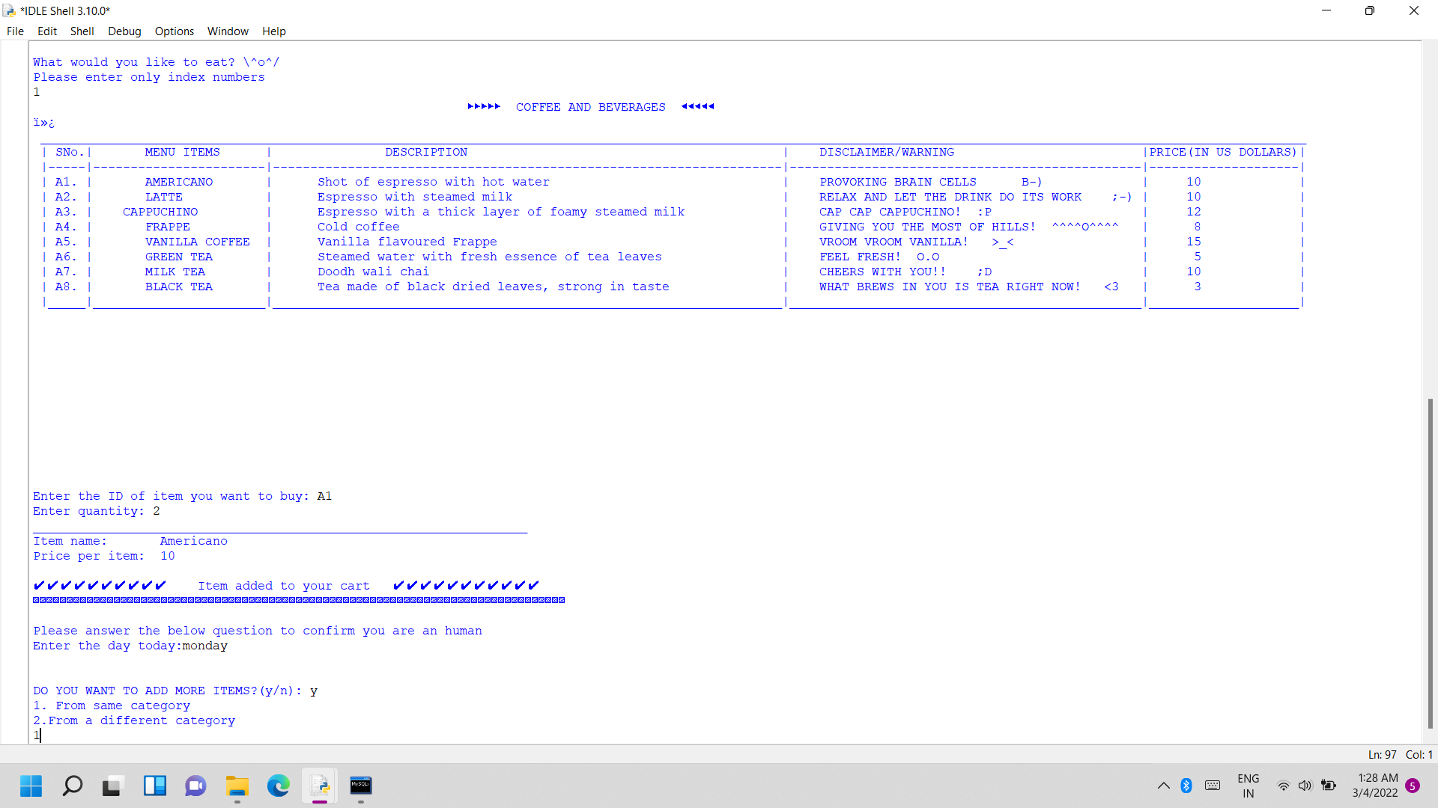
d) Customer opting to choose more items from the i. From the same category and entering the quantity

Slide 12
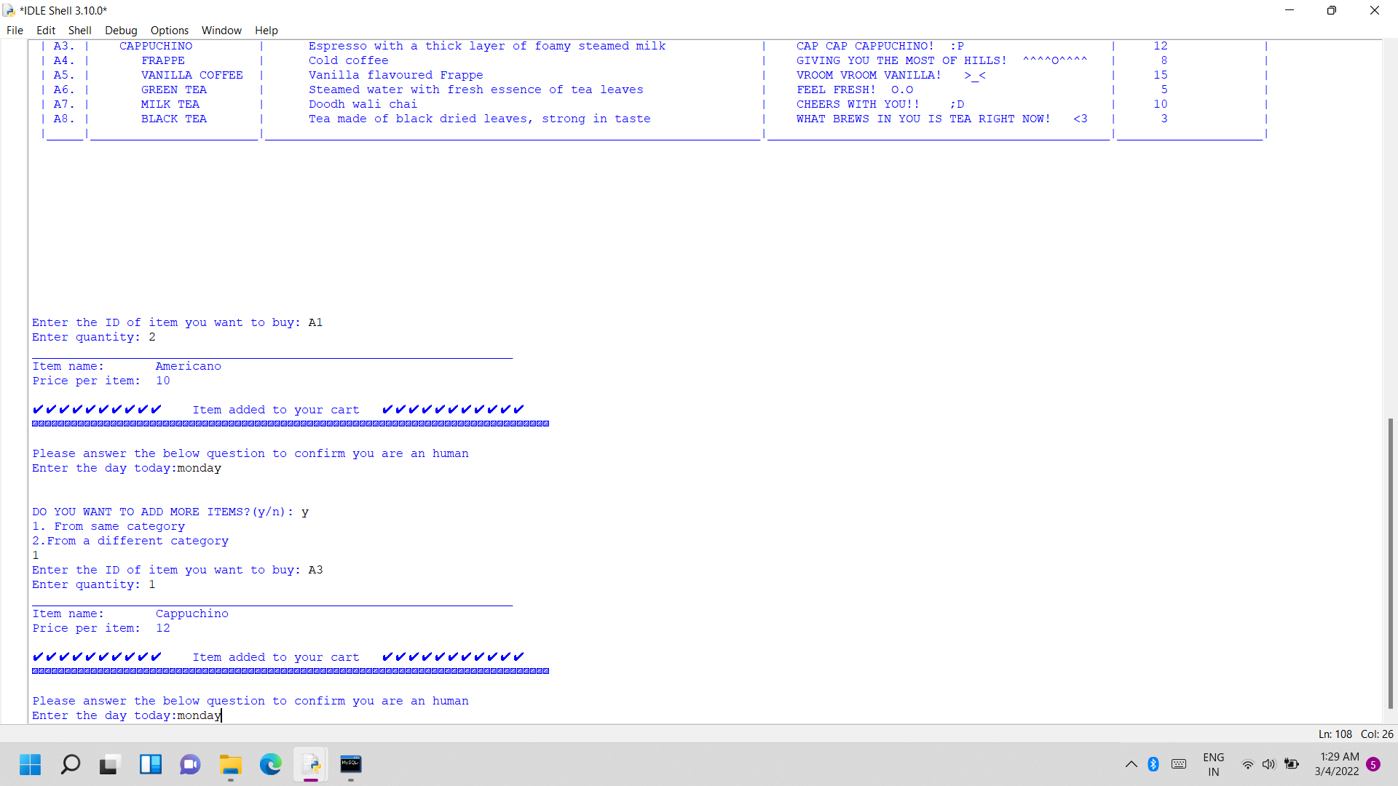

Slide 13
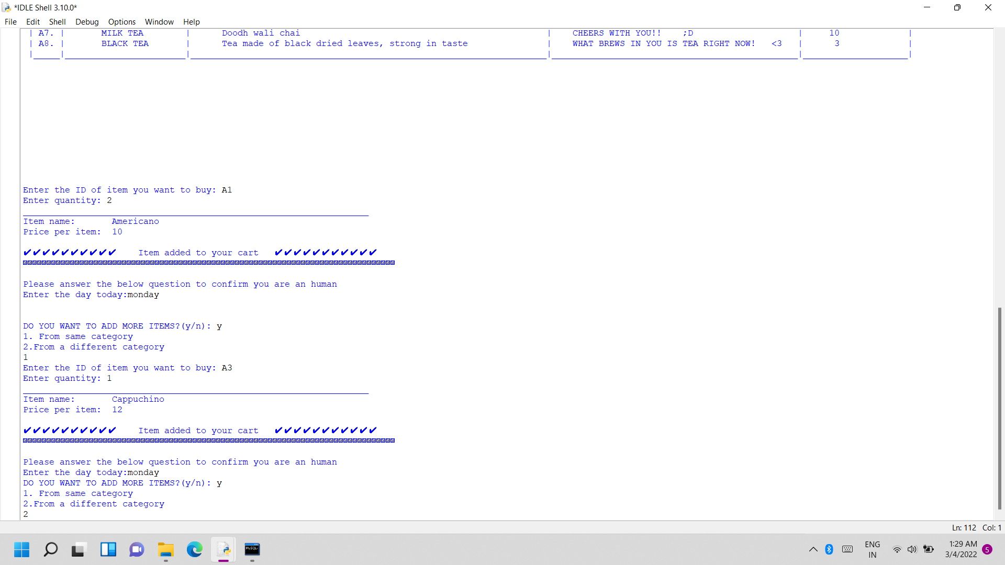
ii. From different category and entering the quantity:

Slide 14
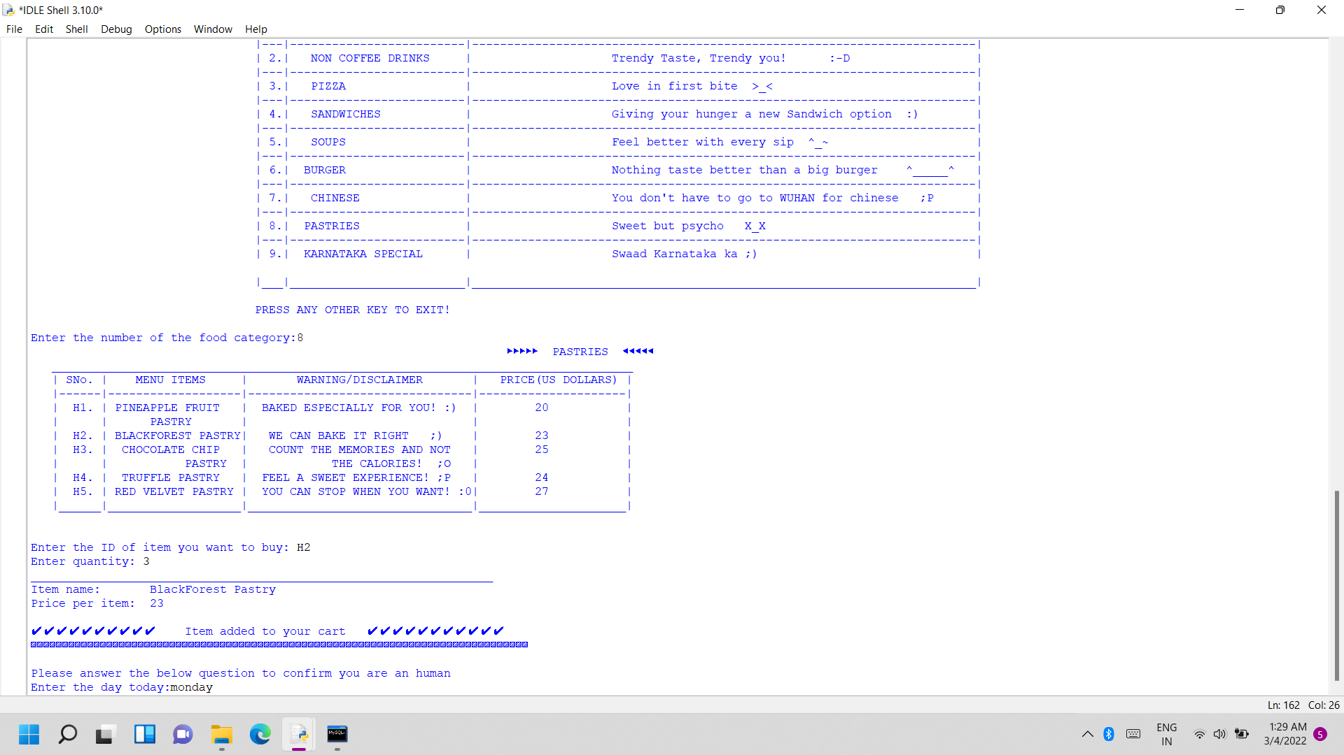

Slide 15
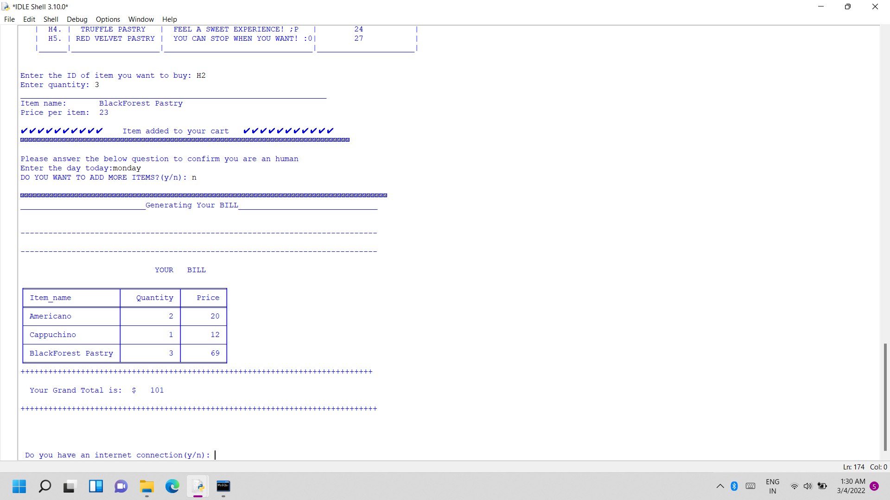
f. Generating the bill for the customer:

Slide 16
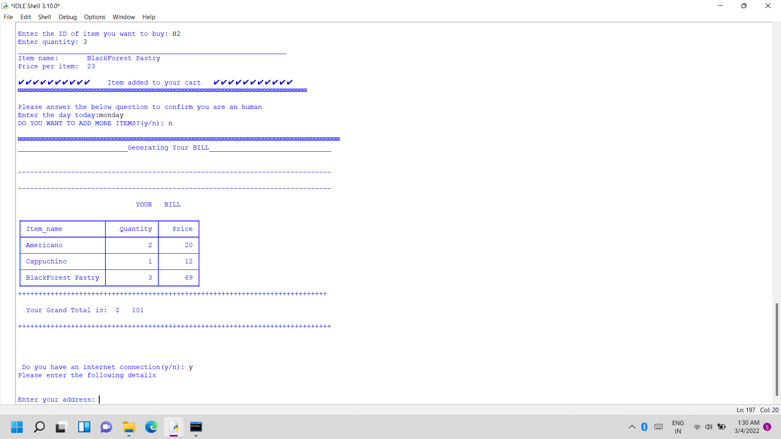
g) Making the customer enter his details and asking for the confirmation code to finalise the purchase:
i) Customer has an internet connection:
Customer entering yes(y) for internet connection:

Slide 17
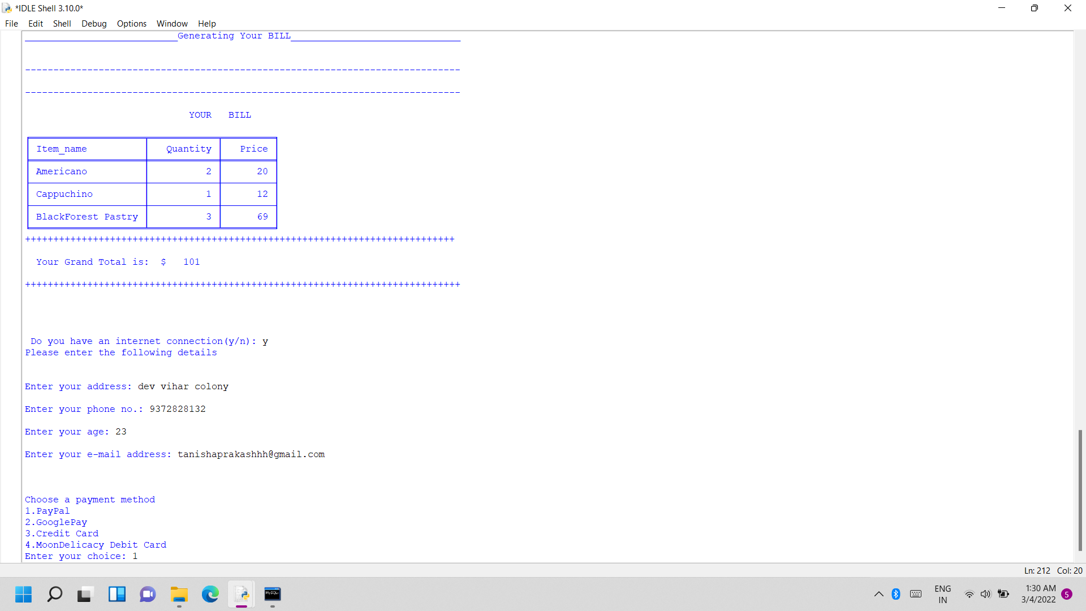
Customer entering details:

Slide 18
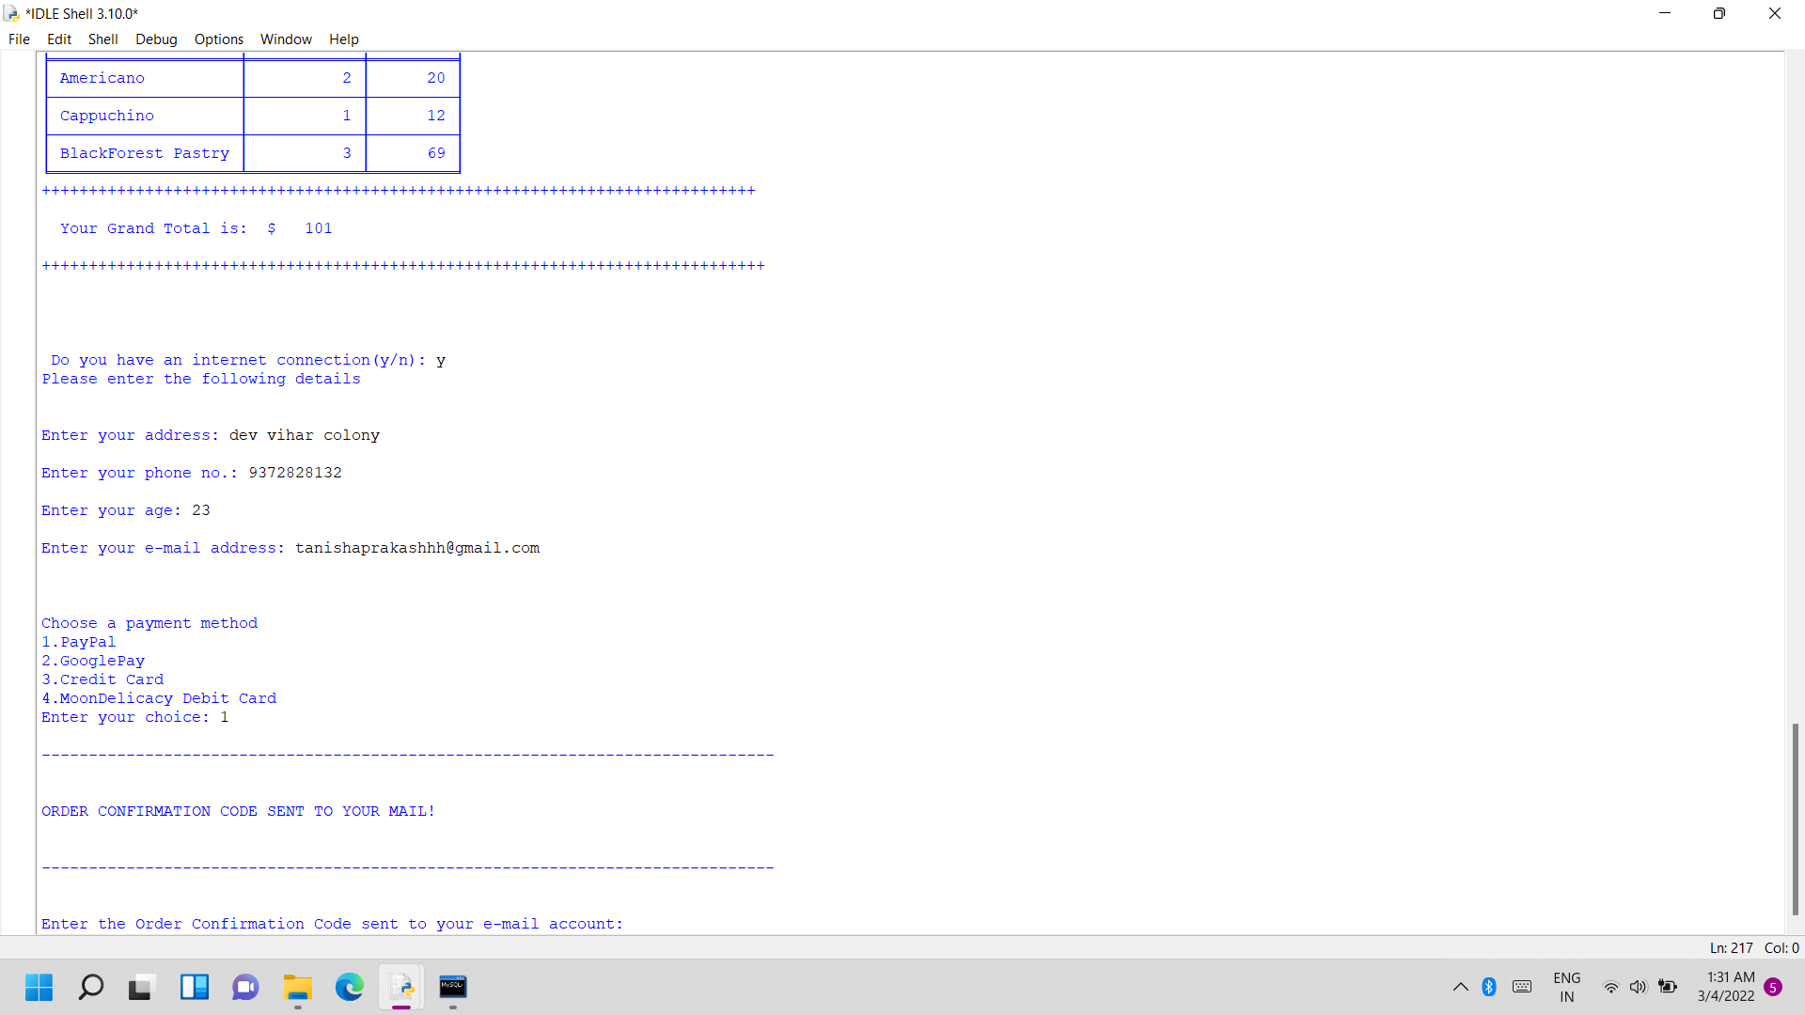
Confirmation code sent to email:

Slide 19
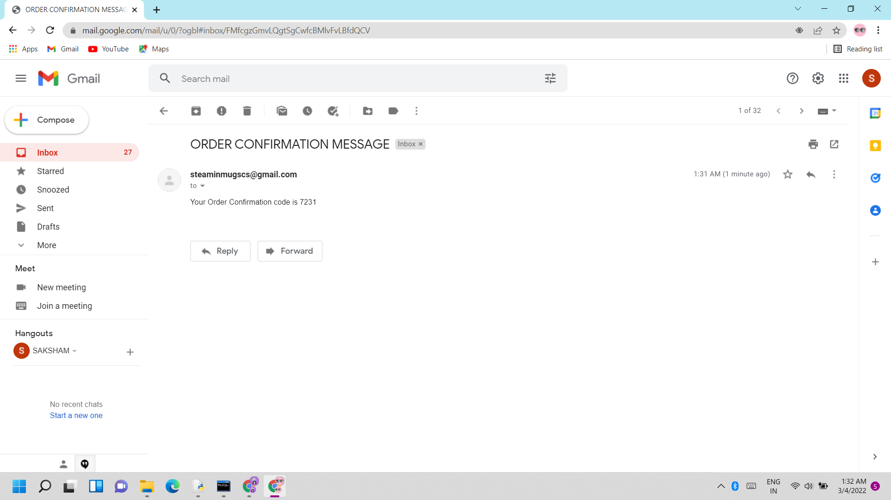

Slide 20
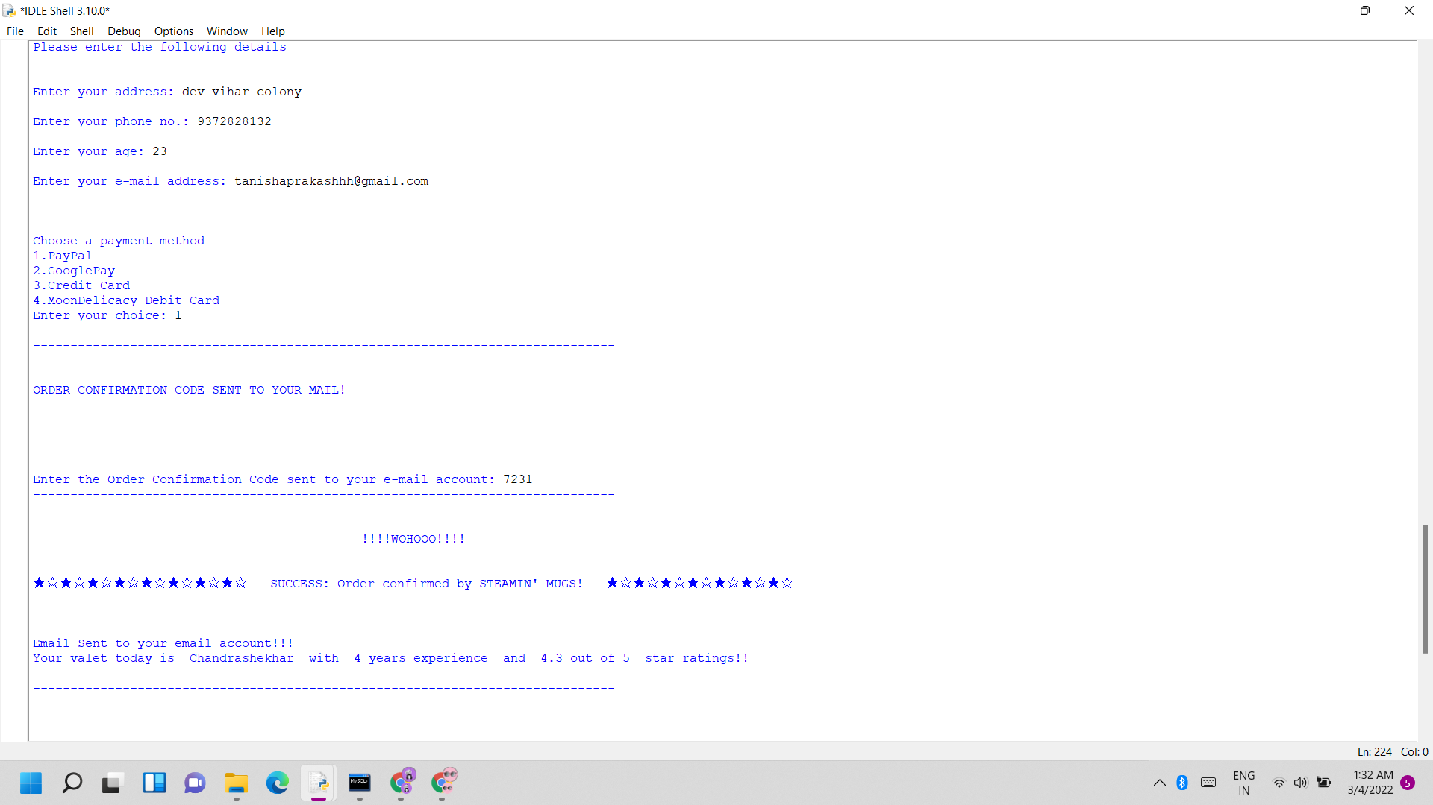
Customer entering the confirmation code in python:
If matches with the sent code:
Success message displayed!

Slide 21
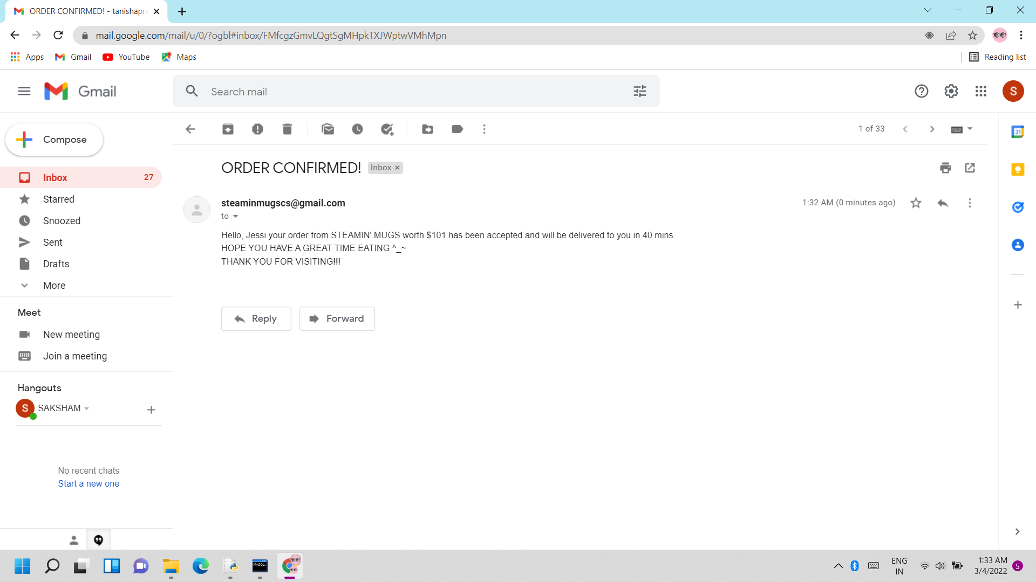
Order successful message sent to the entered email

Slide 22
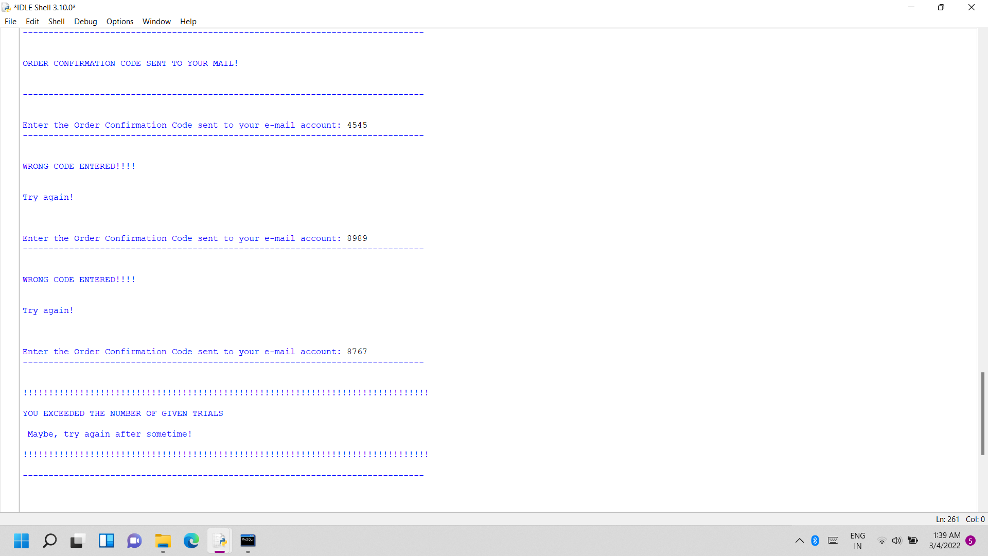
If entered code doesn’t match with the sent code:
Exceeded given number of trials!

Slide 23
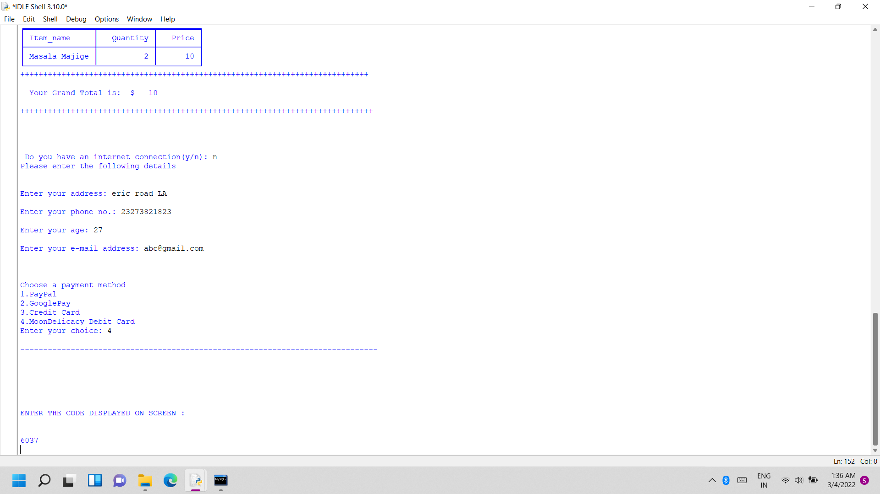
ii) Customer doesn’t have an internet connection:
Customer enters no(n) for internet connection and enters details and the confirmation code displayed on screen itself.
Confirmation code displayed on screen!

Slide 24
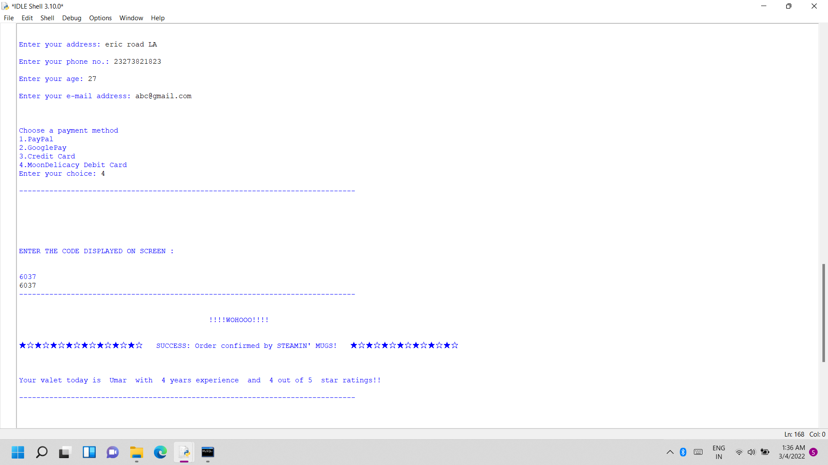
If matches with the displayed code:
Success message displayed!

Slide 25
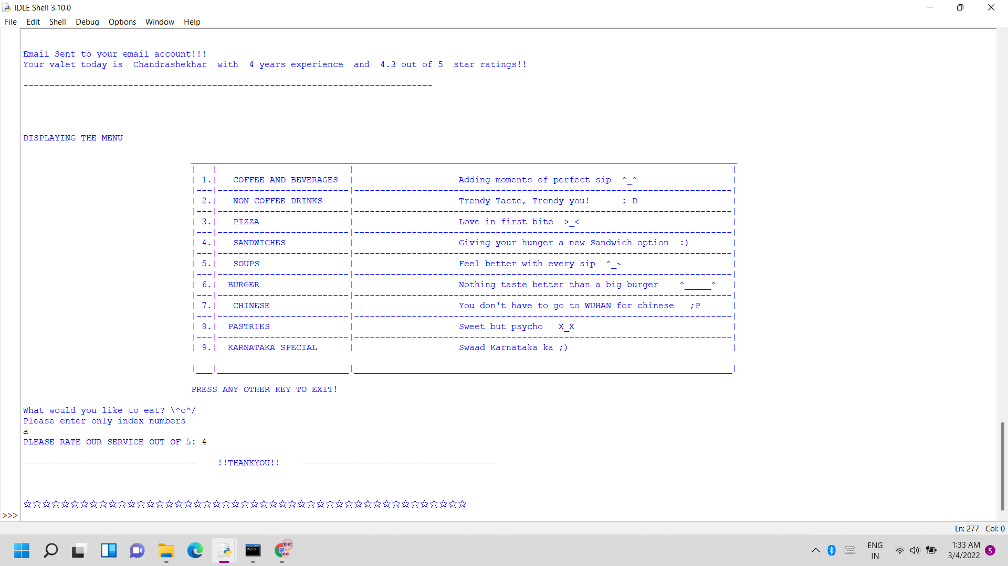
h. Making the customer rate our service and ending the customer program:

Slide 26
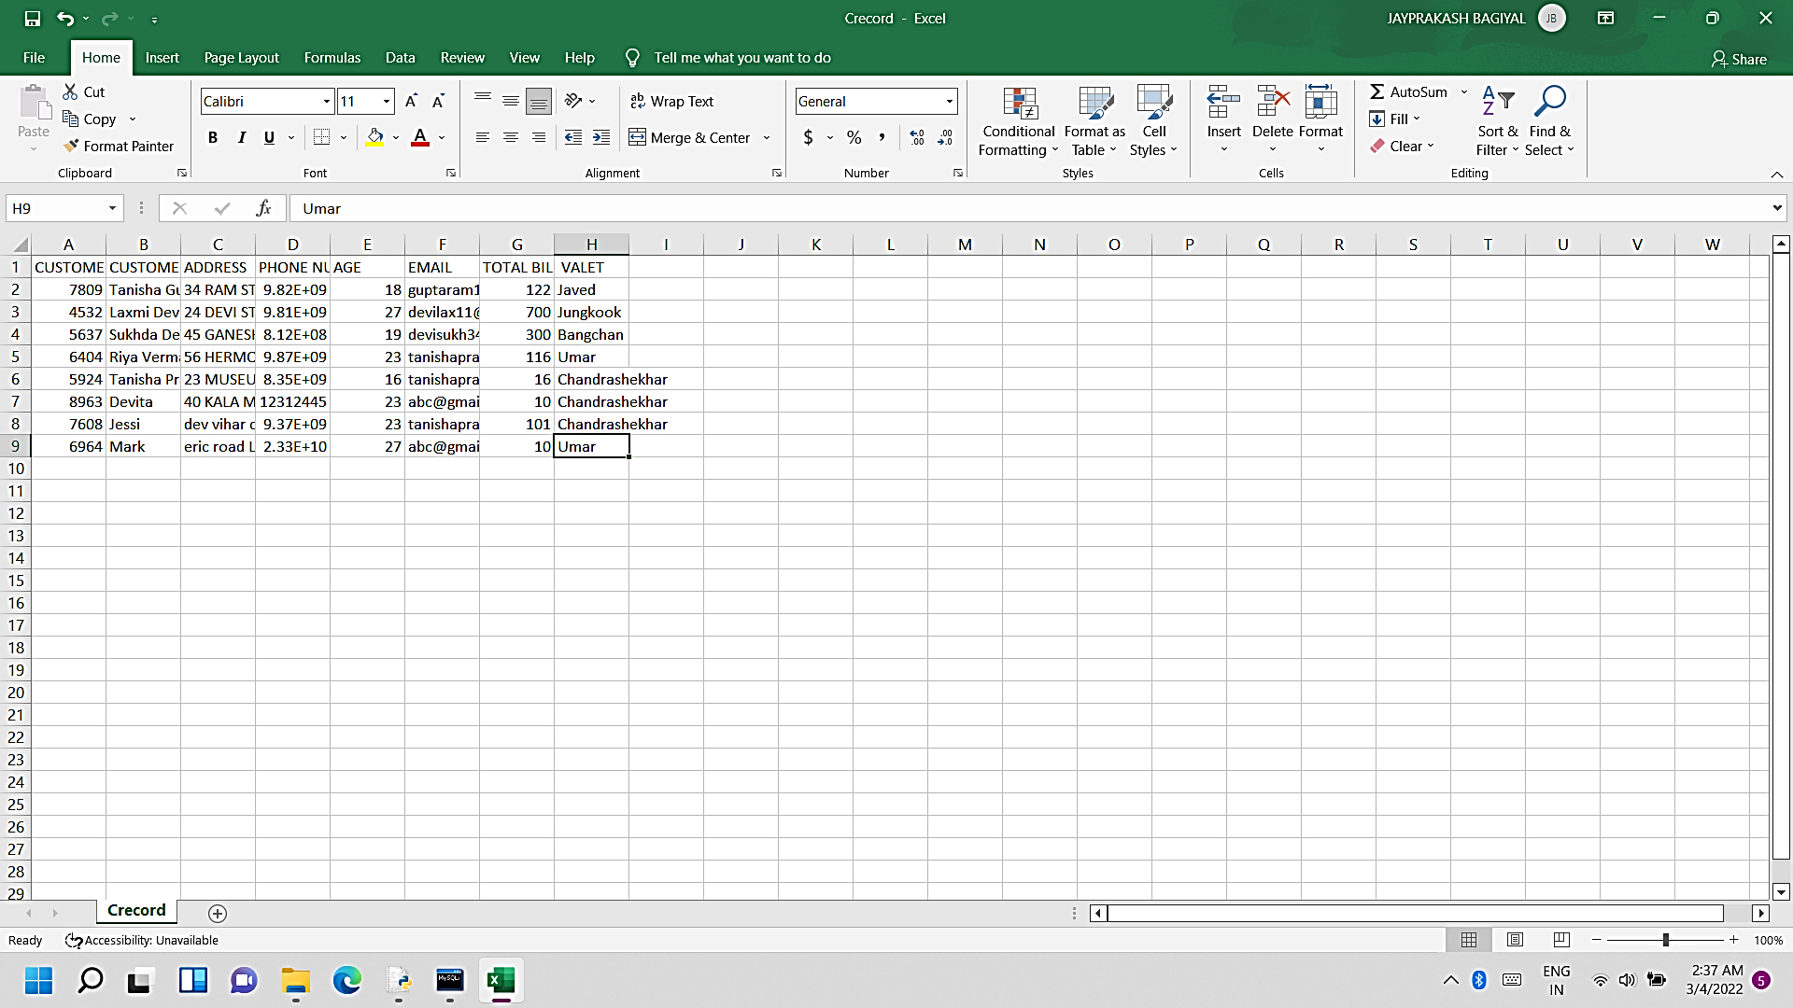
i. Customer record getting saved in csv file:

Slide 27
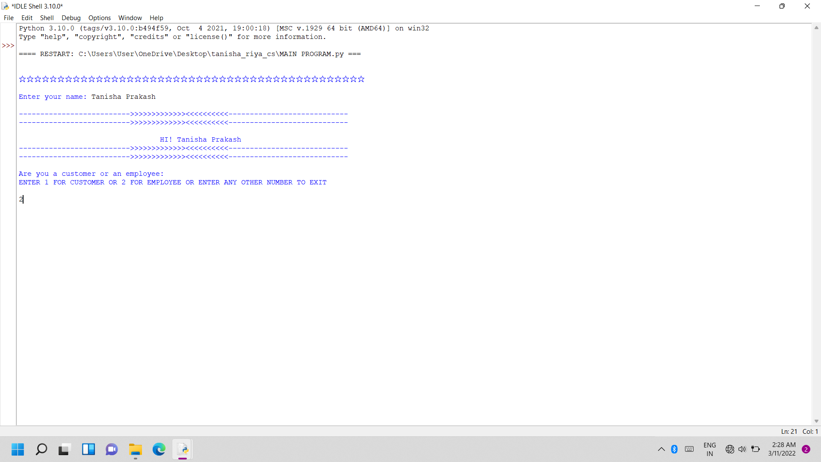
Choosing to be a retailer

Slide 28
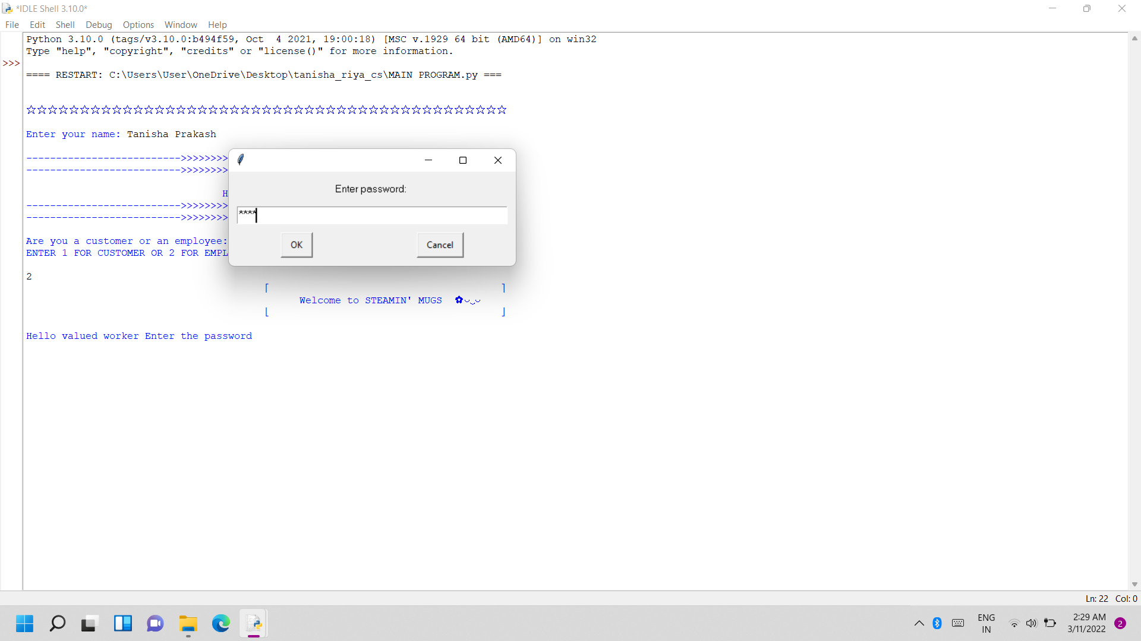
a. Asking verification password for retailer. If correct, then retailer tasks displayed otherwise the program ends for the user.

Slide 29
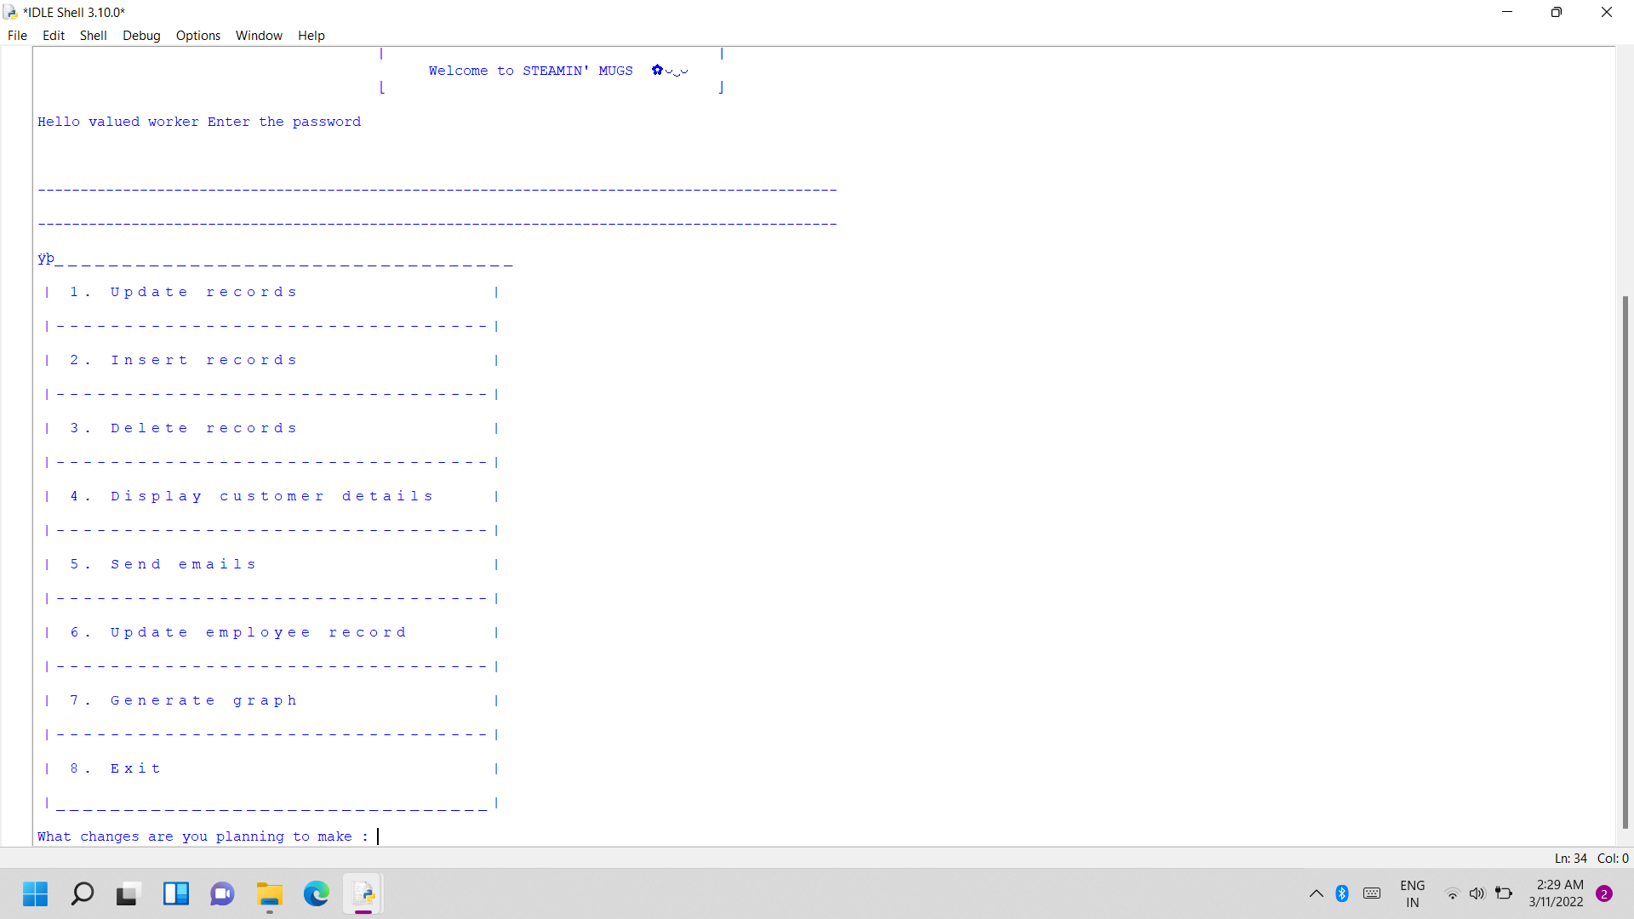
CORRECT PASSWORD!

Slide 30
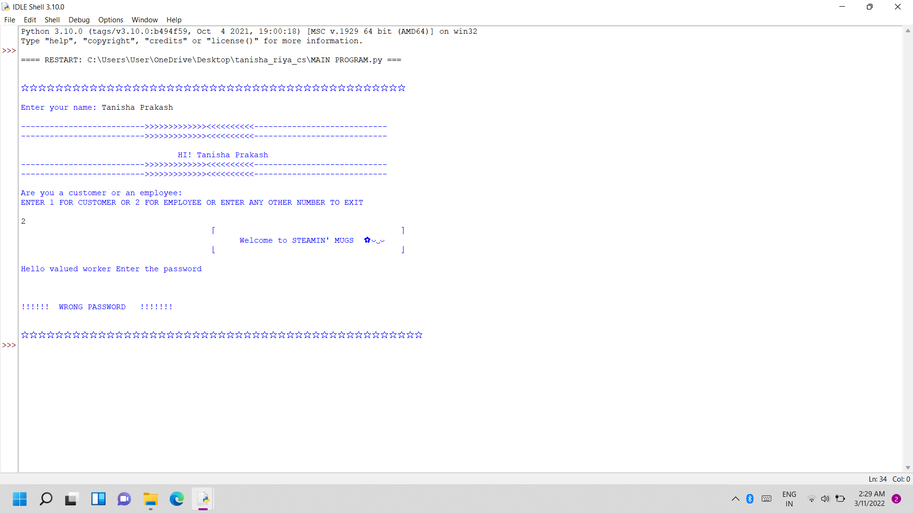
INCORRECT PASSWORD!

Slide 31
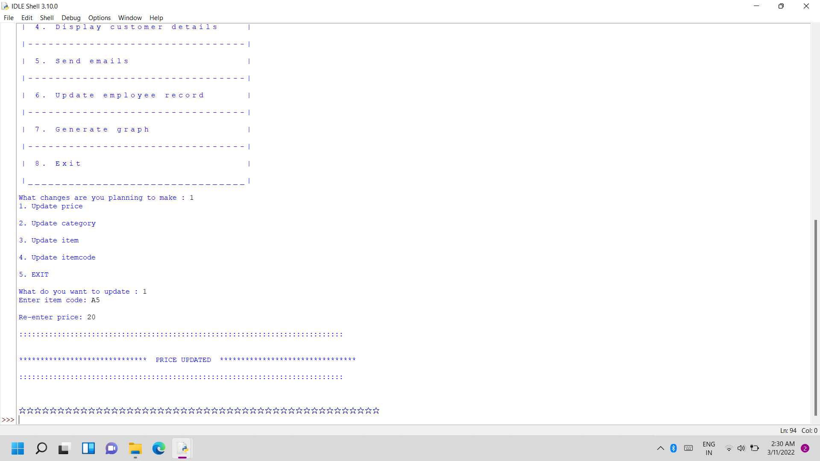
Updating item records
Updating price

Slide 32
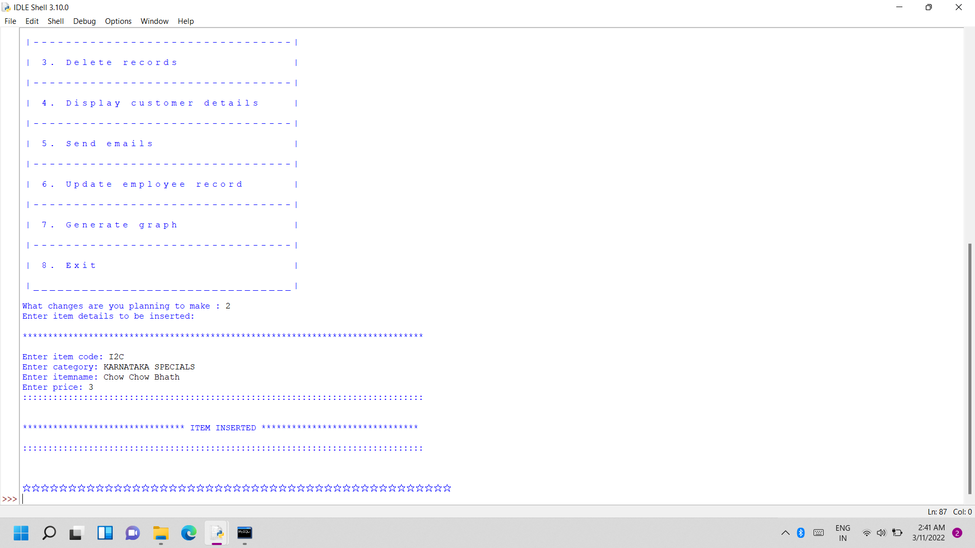
c. Inserting item to the menu table

Slide 33
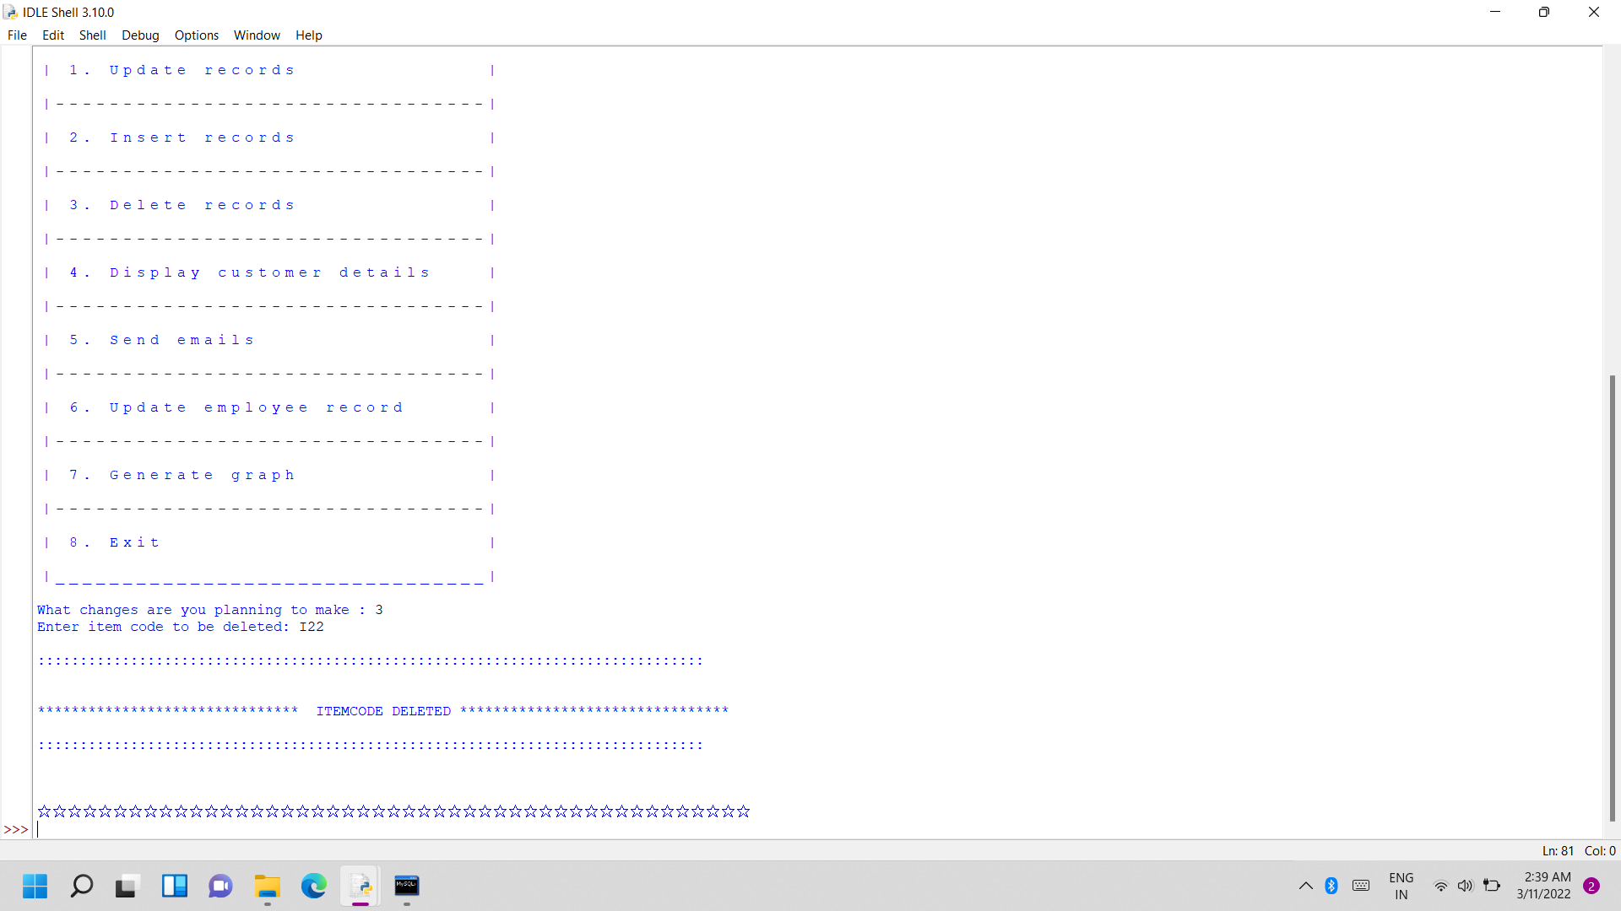
d. Deleting records from menu file

Slide 34
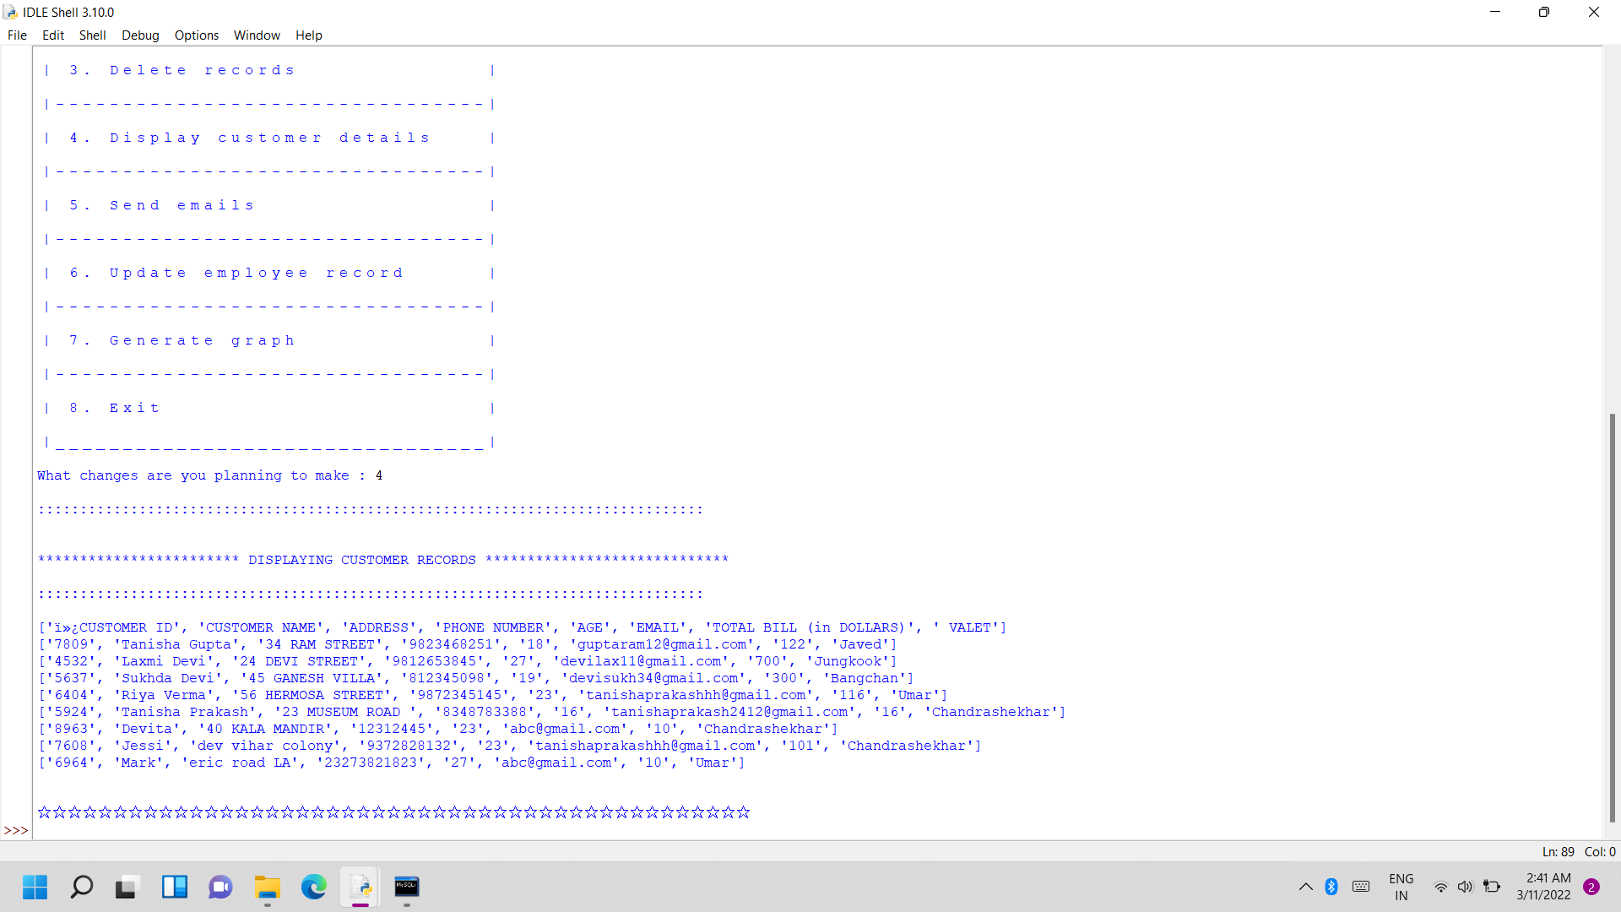
e. Displaying customer details:

Slide 35
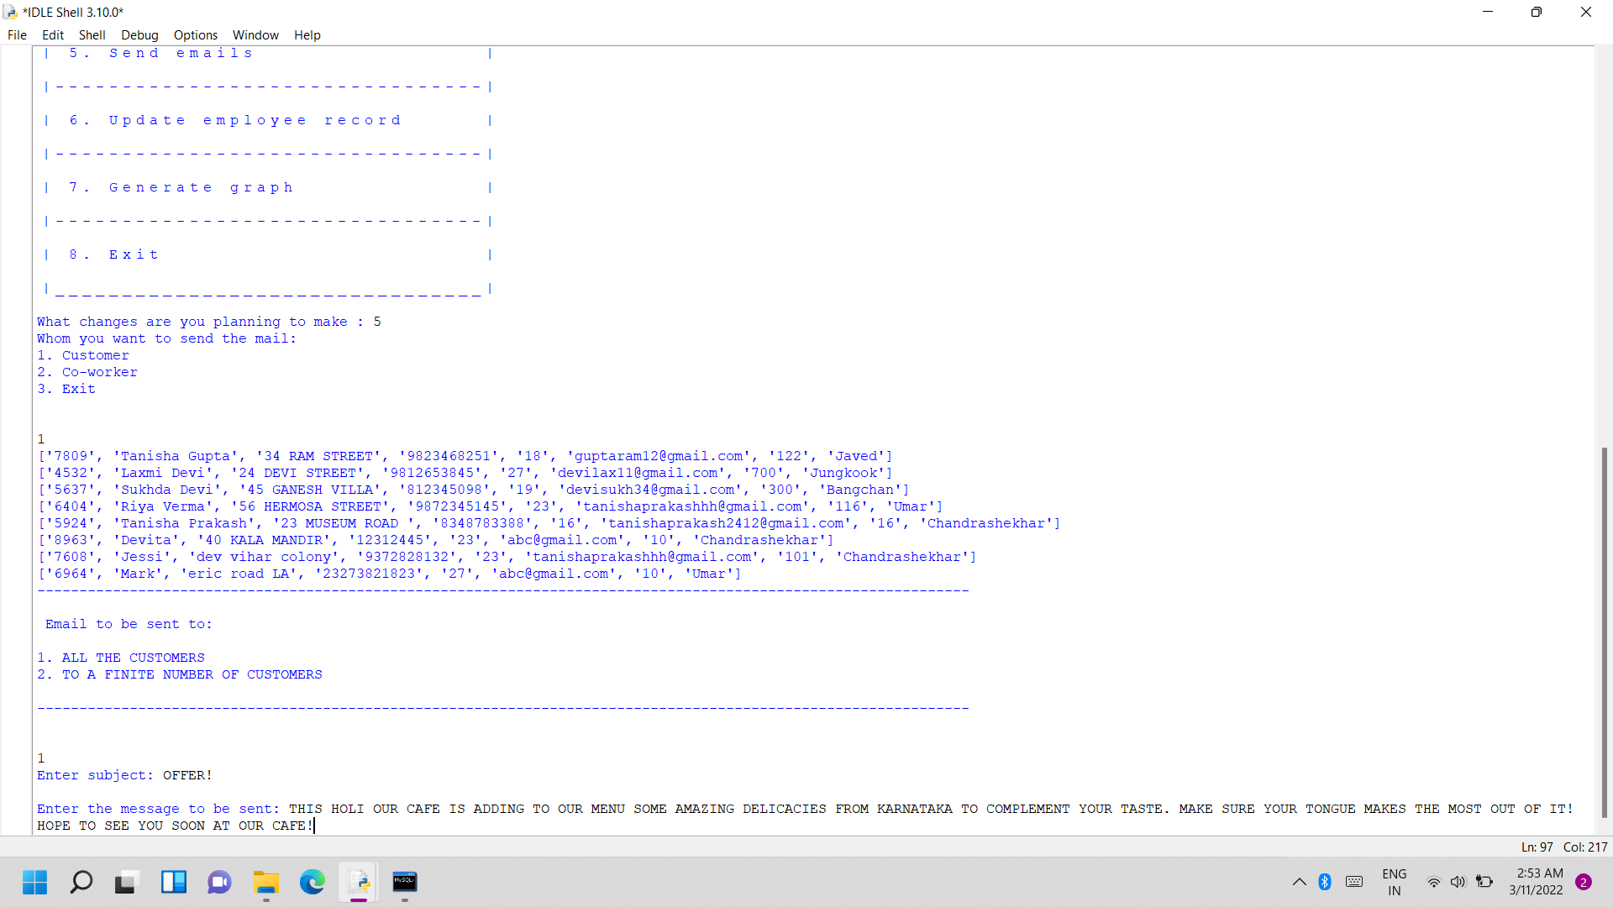
f. Sending emails:
To all the customers
Forming the message to be sent
FRAMING THE MESSAGE TO BE SENT TO ALL CUSTOMERS

Slide 36
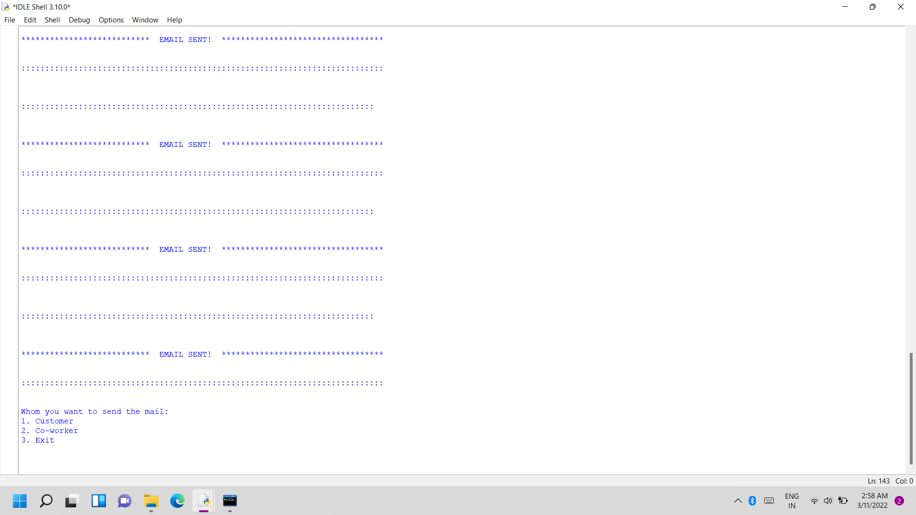
Email sent to all customers:
EMAIL SENT TO ALL CUSTOMERS

Slide 37
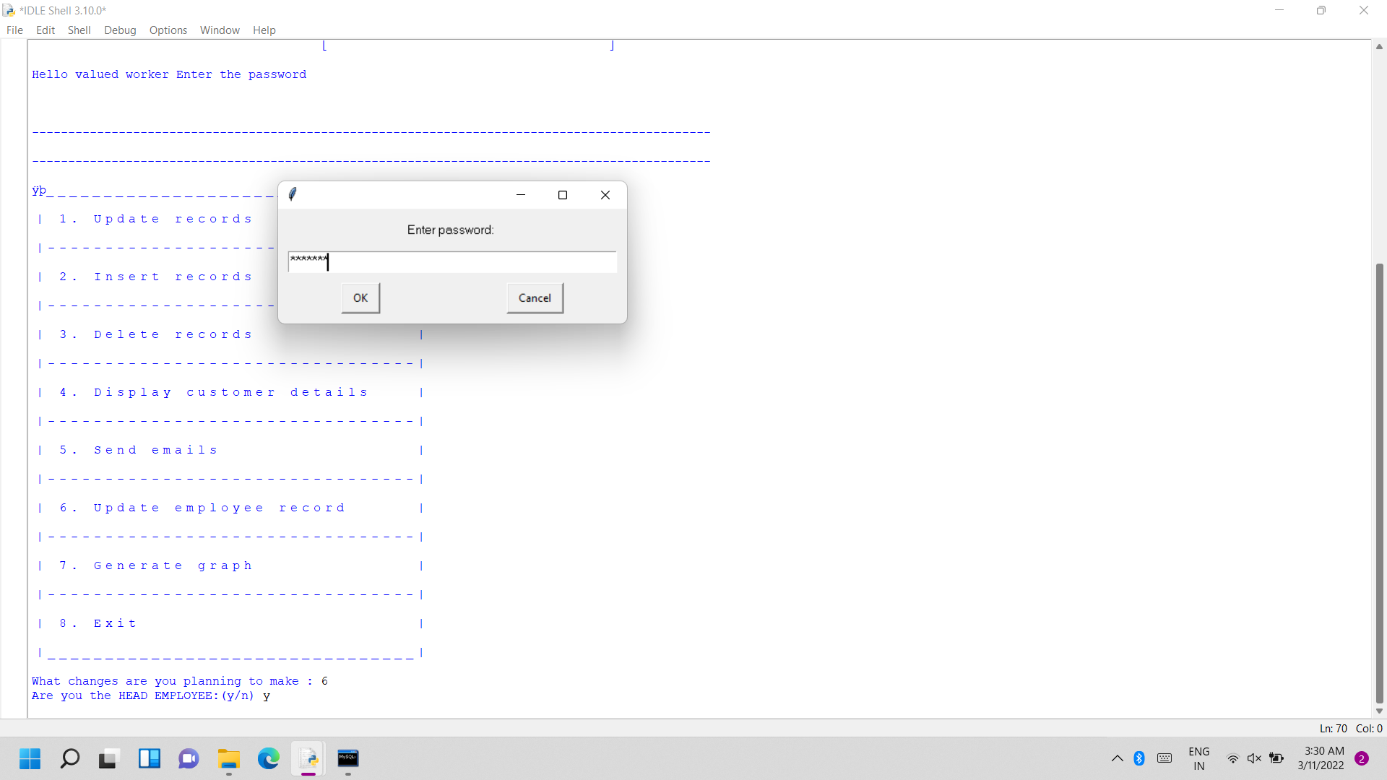
g. Updating employee records (service only available for the head employee):
entering password as a head employee, if correct allowed to make changes, otherwise forbidden to make the changes:

Slide 38
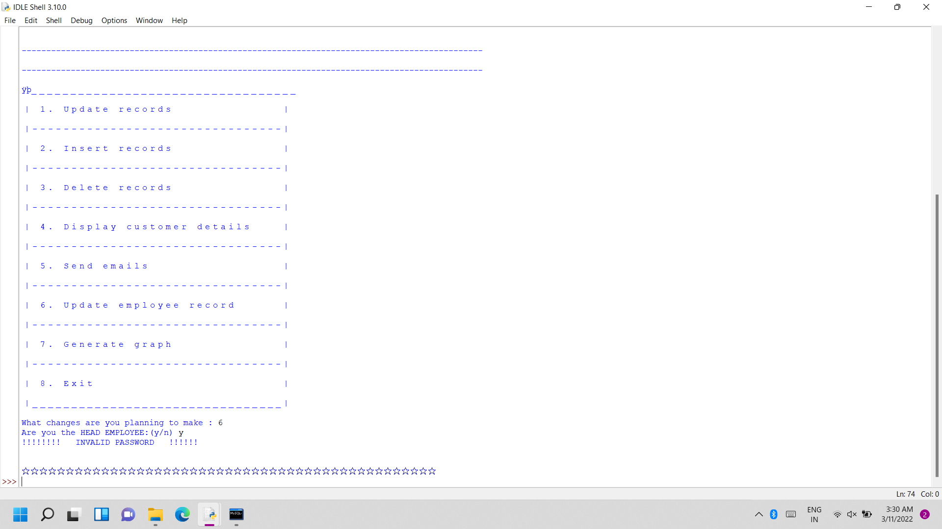
If password incorrect:
PASSWORD INCORRED, SO NOT ALLOWED TO MAKE CHANGES IN THE EMPLOYEE FILE

Slide 39
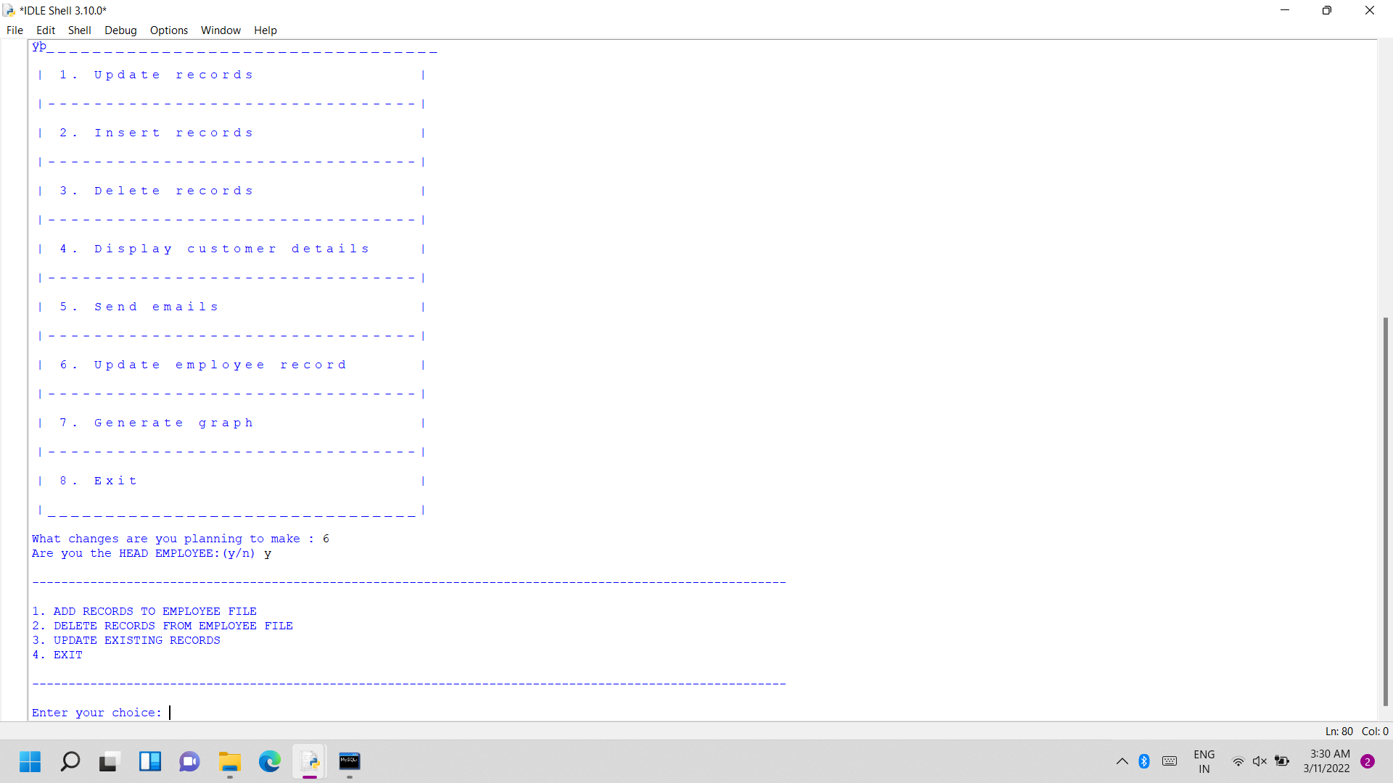
If password correct:
PASSWORD CORRECT, SO CHOICES DISPLAYED

Slide 40
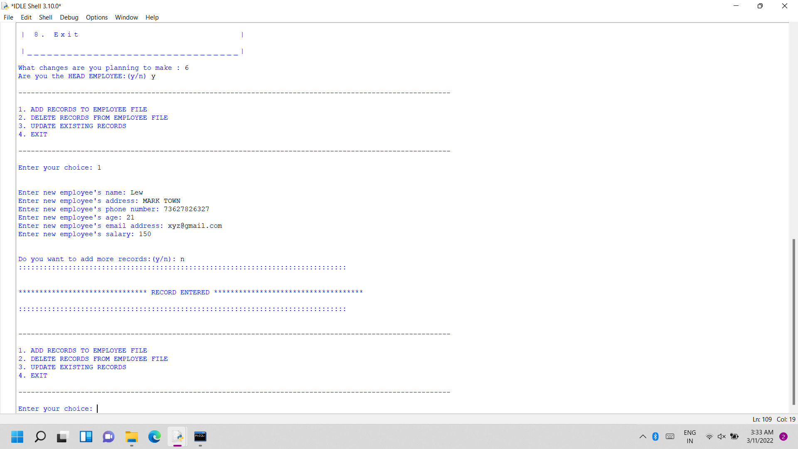
ii) adding records to the employee file:
RECORD ENTERED

Slide 41
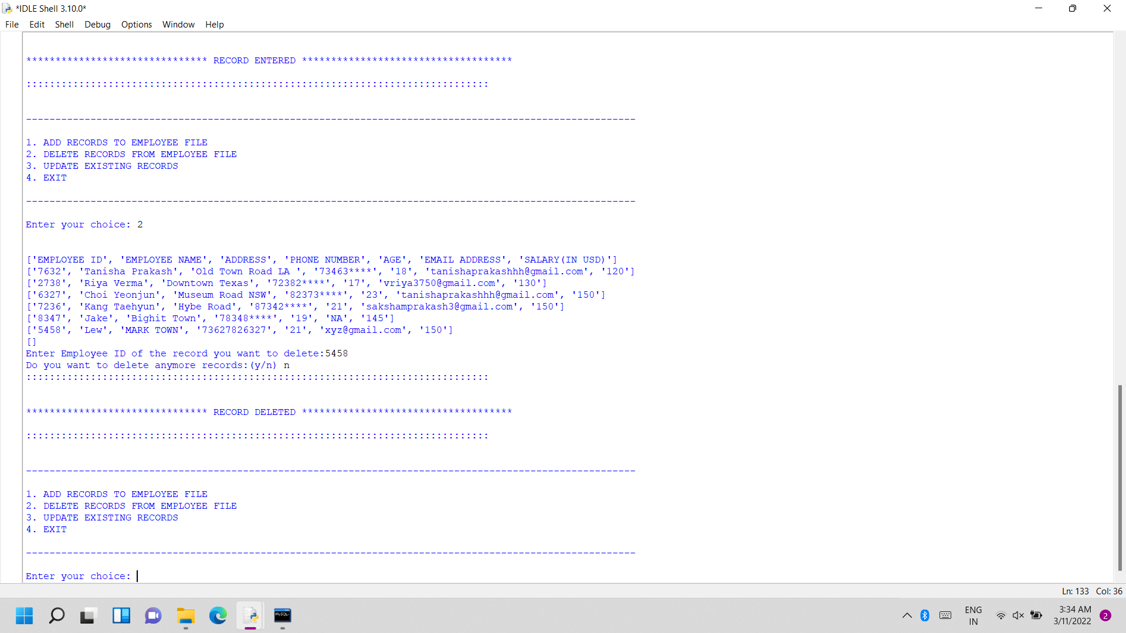
iii) deleting record from the employee file:
RECORD DELETED

Slide 42
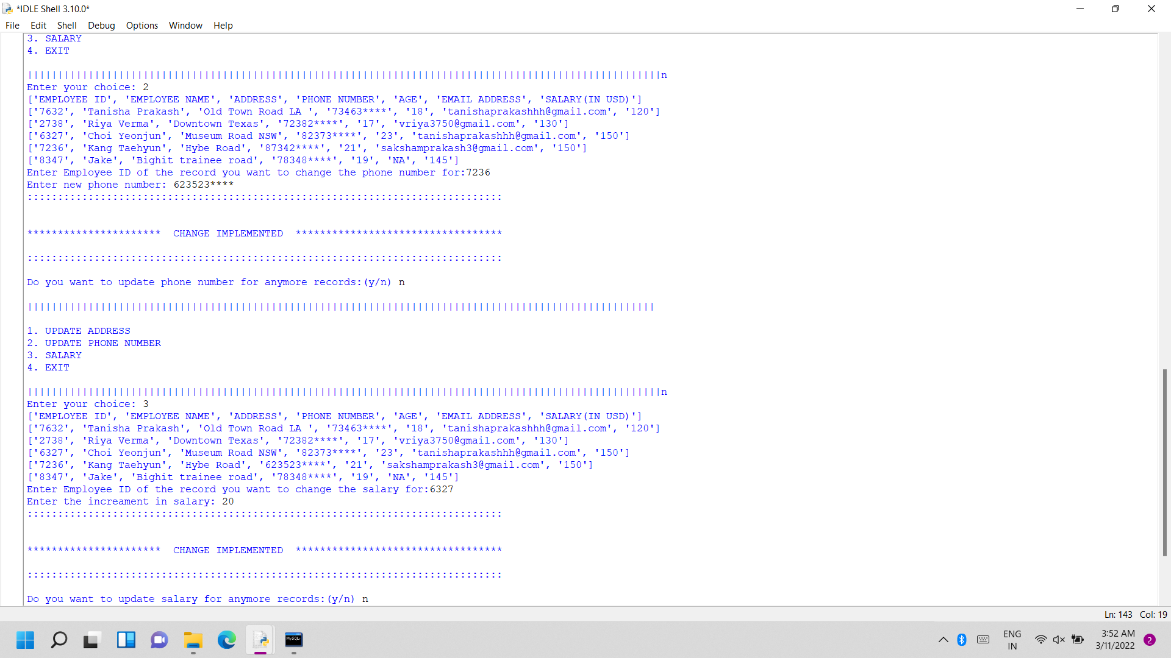
iv) updating existing records of the employee:
UPDATING SALARY BY ADDING AN INCREMENT:
SALARY UPDATED

Slide 43
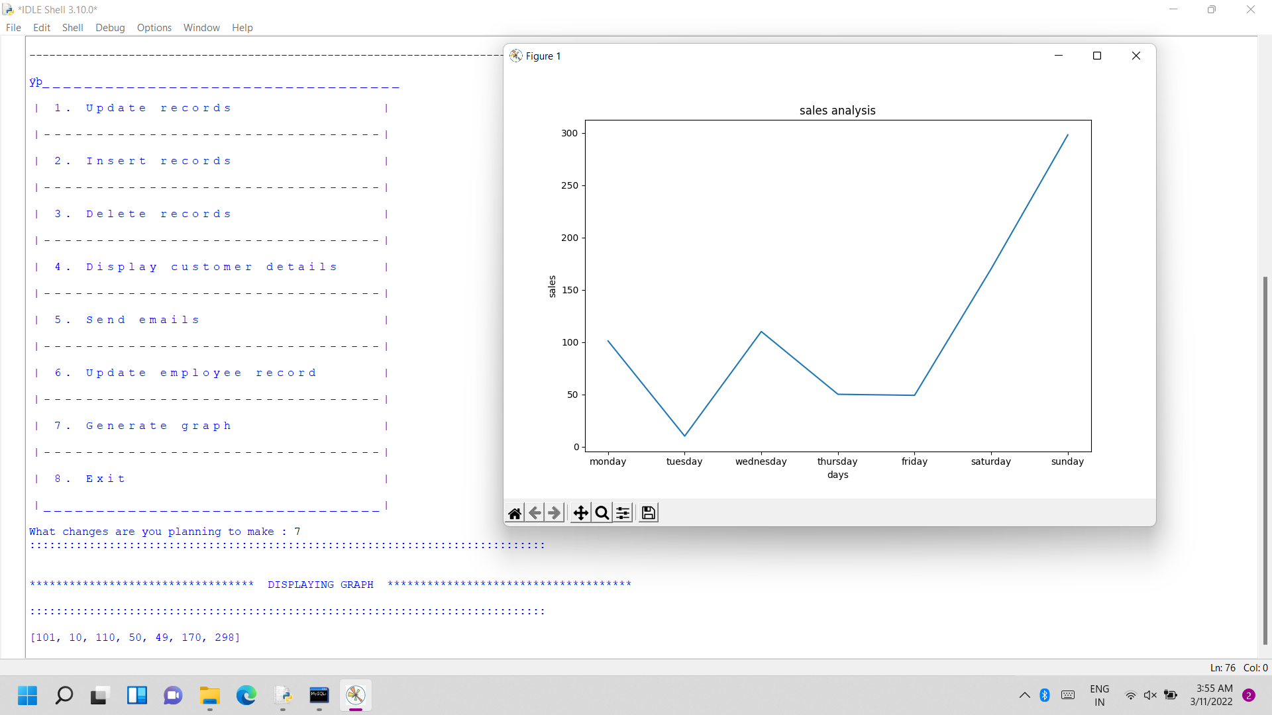
h. DISPLAYING SALES GRAPH FOR DIFFERENT MONTHS:

Slide 44
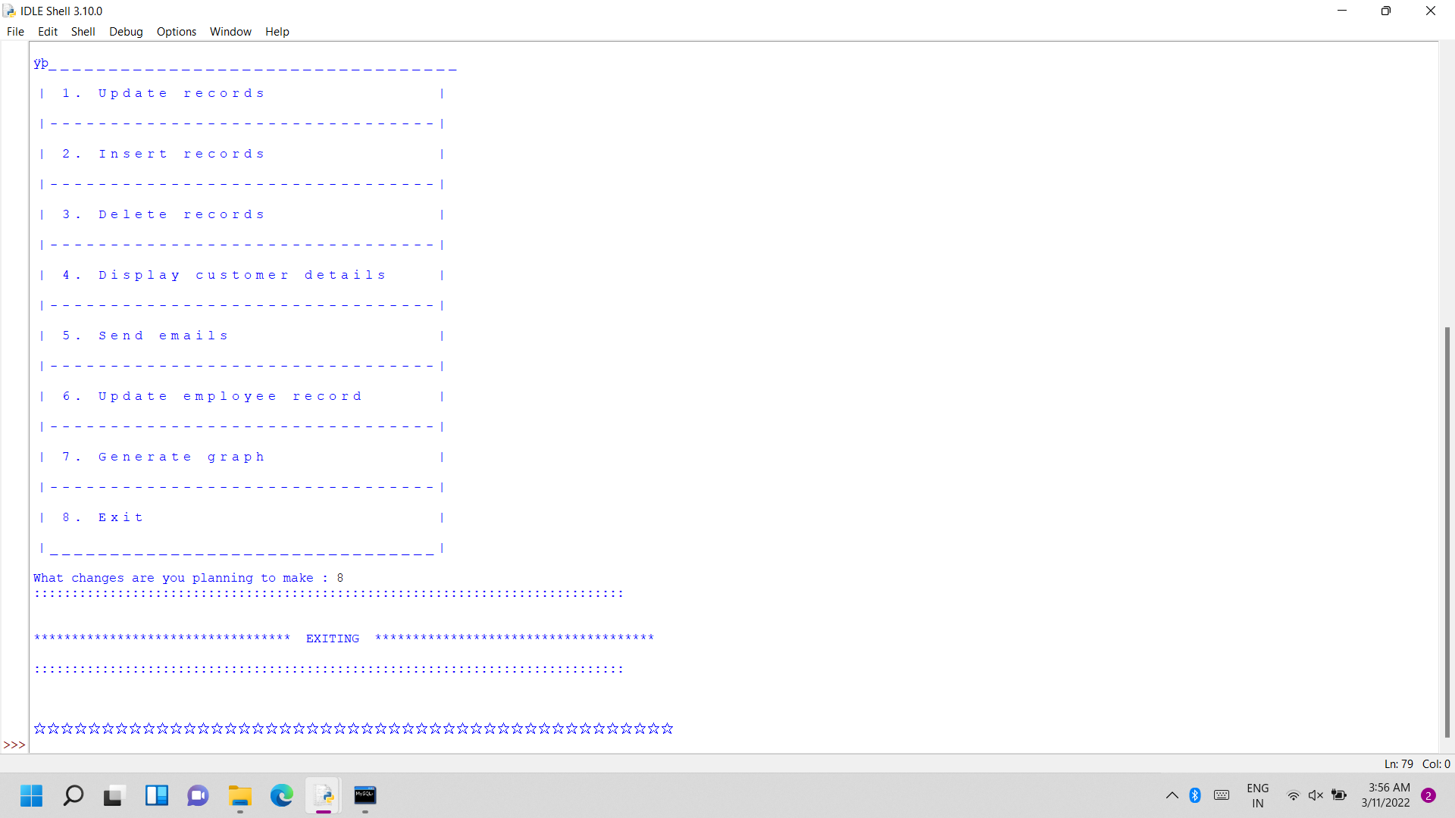
EXITING

Slide 45
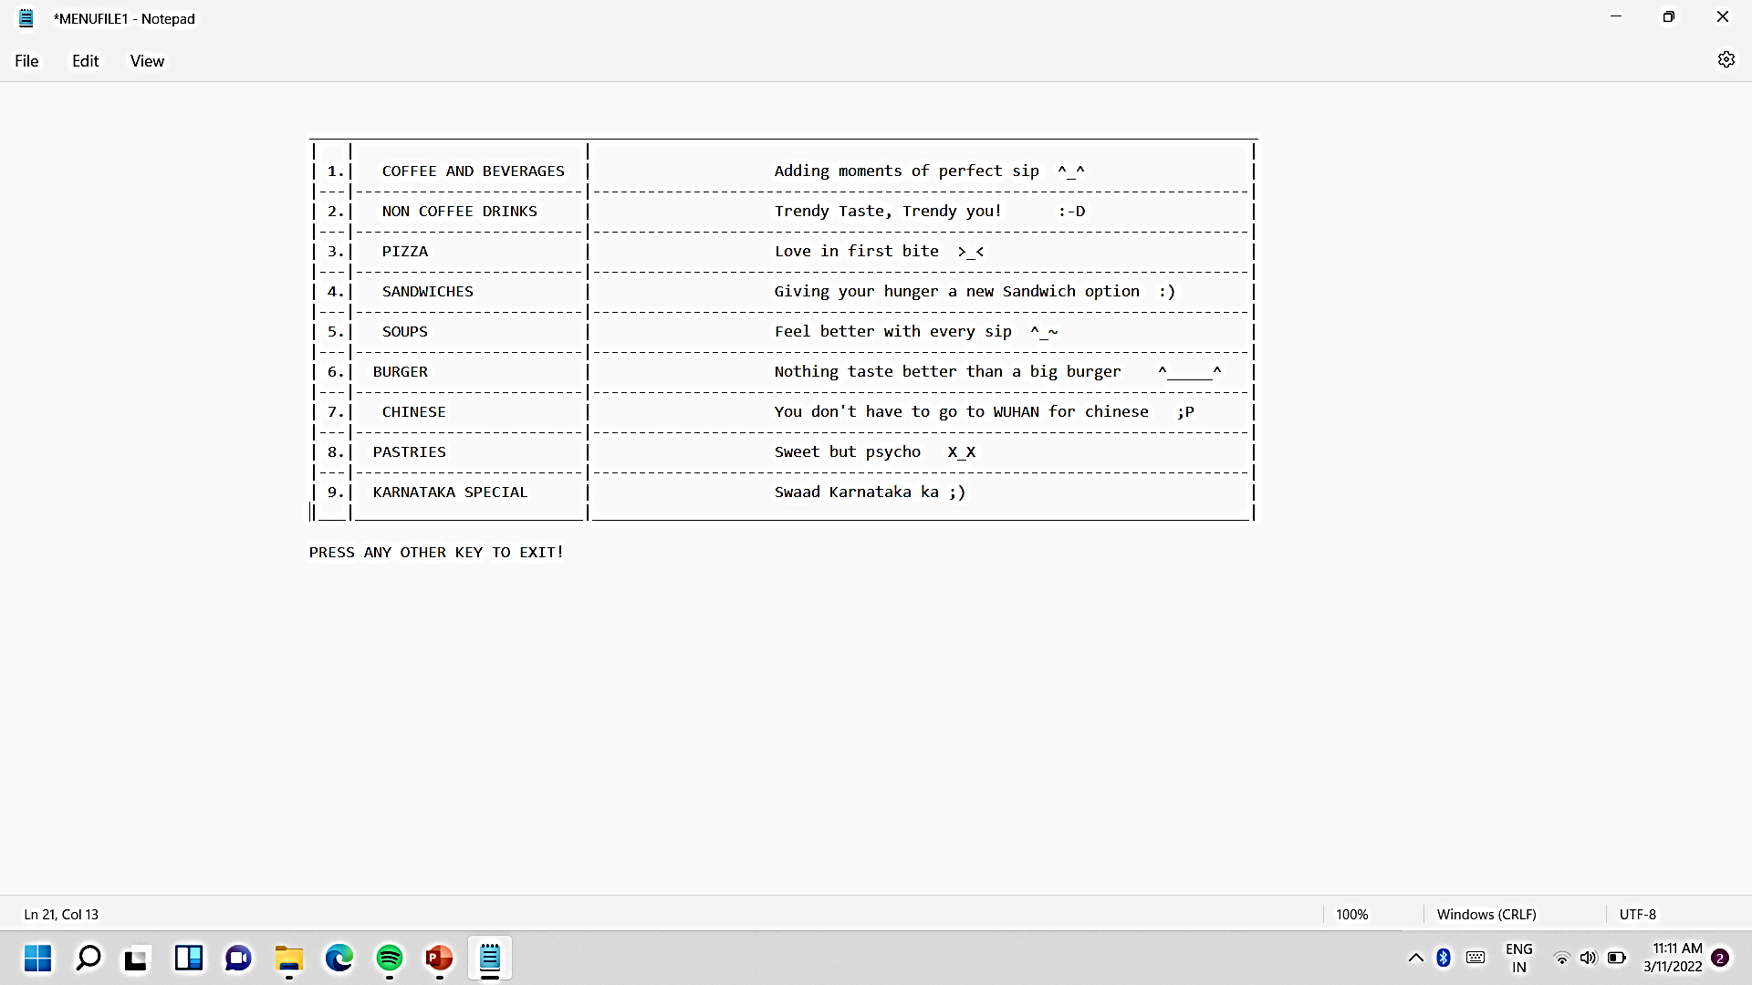
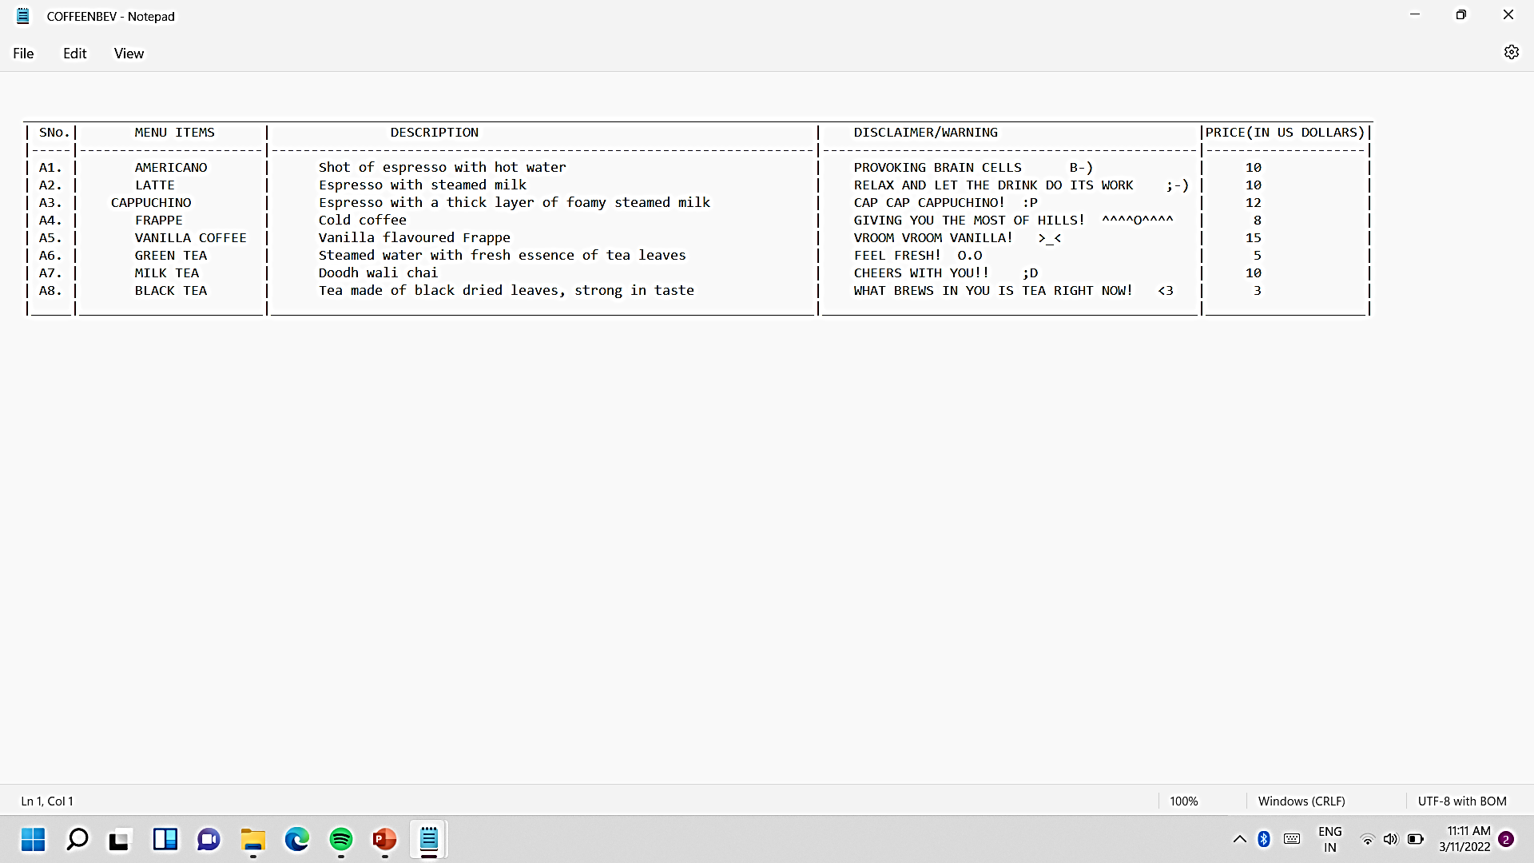
MENU FILE
COFFEE AND BEVERAGES

Slide 46
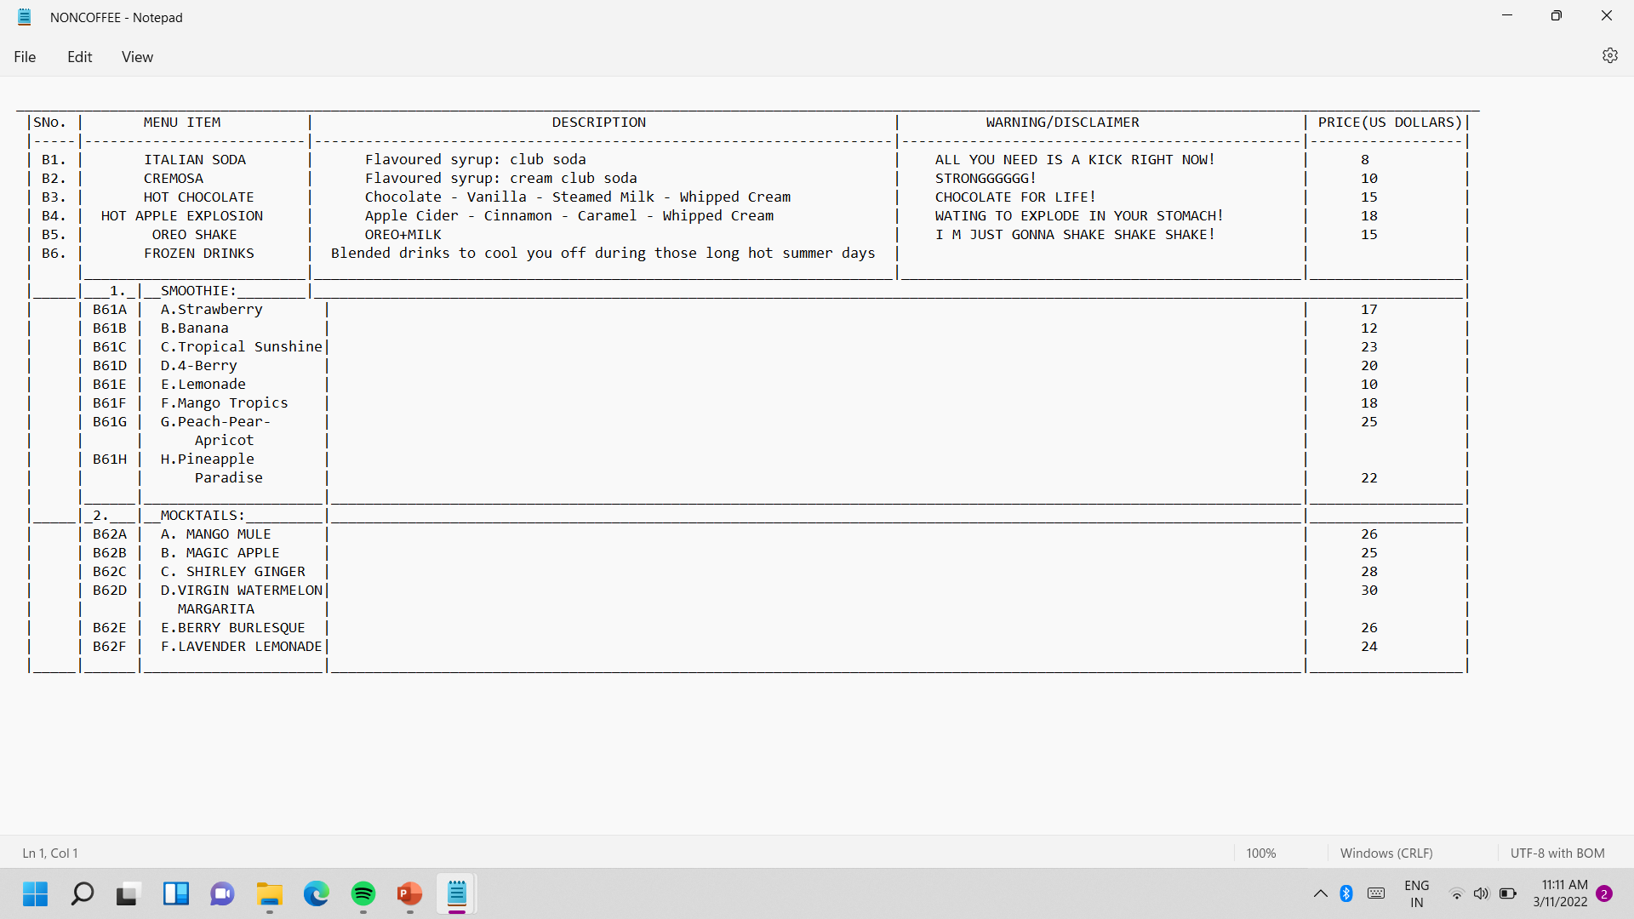
NON COFFEE DRINKS

Slide 47
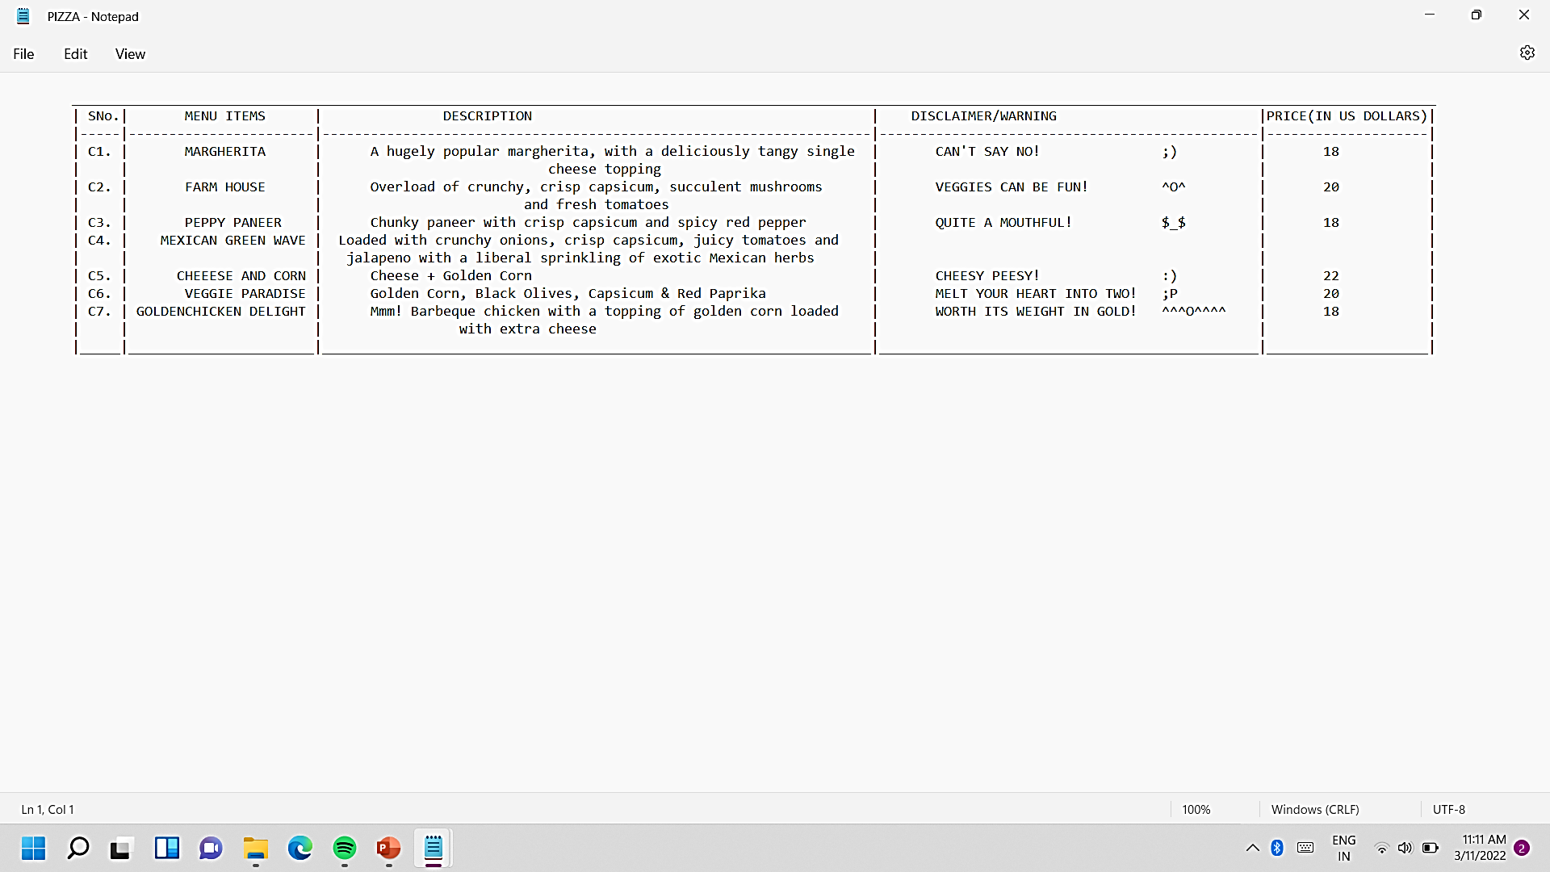
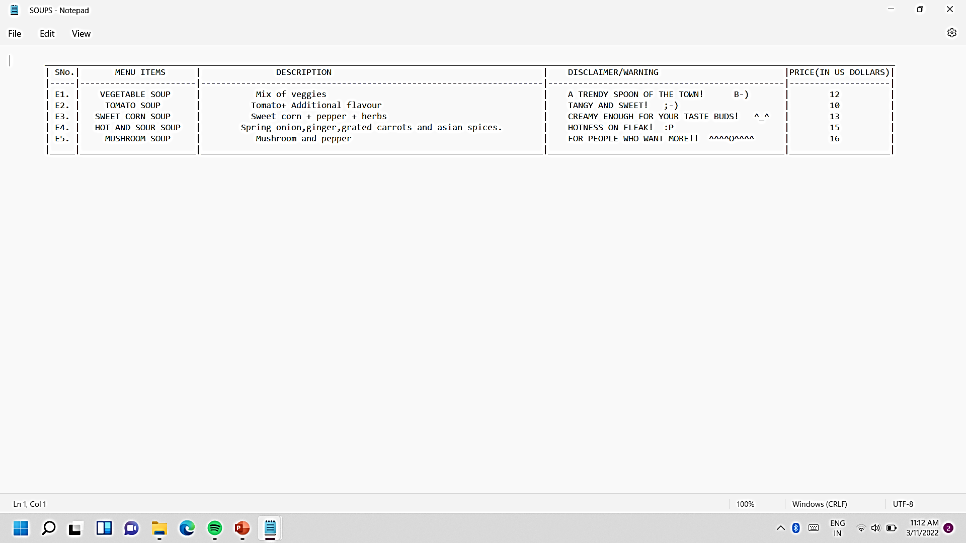
PIZZA
SOUPS

Slide 48
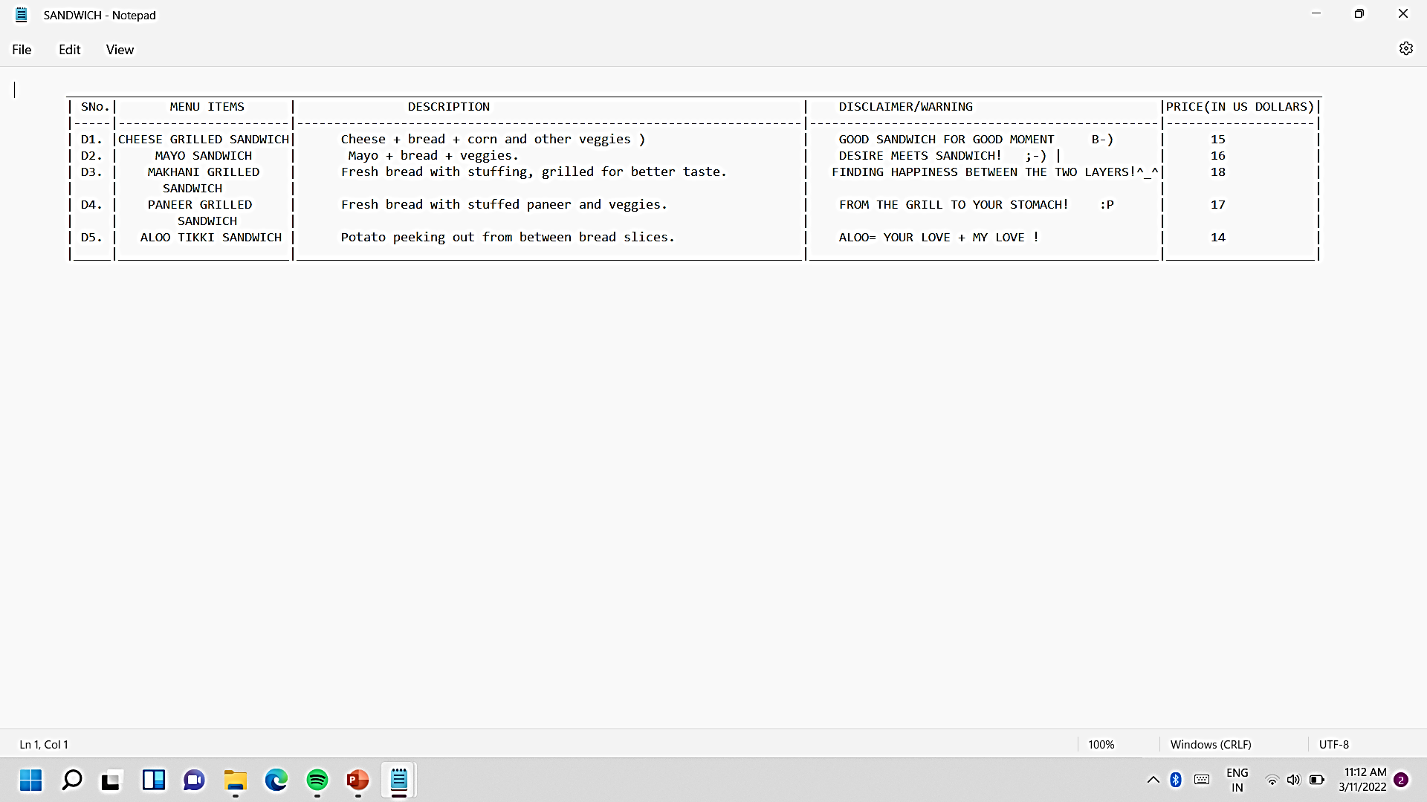

SANDWICH
BURGER

Slide 49


CHINESE
PASTRIES

Slide 50




KARNATAKA SPECIAL
RETAILER
UPDATE
EMAIL CONTENT

Slide 51



CUSTOMER RECORD
VALET RECORD
EMPLOYEE RECORD

